Slide 1
Quality Talks
Specific Review Standard 5.3
8th Annual Conference on Quality Assurance in Online Learning, "Blazing New Trails"

Slide 2
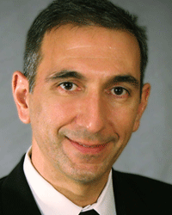





Eddie Andreo
Lisa Clark
Belle Cowden
Steven Crawford
JJ Johnson
Lisa Kidder

Slide 3
Session Objectives
Describe various ways to meet QM Specific Standard 5.3
Compare the benefits of the various approaches to meeting the expectations of QM Specific Standard 5.3
Apply the principles of QM Specific Standard 5.3 to their course design

Slide 4
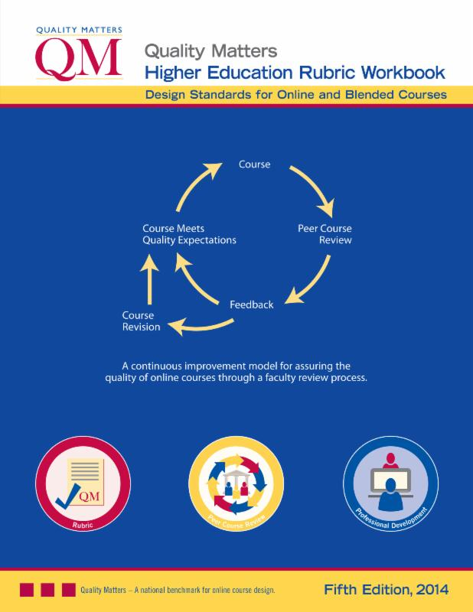
SRS 5.3
The instructor’s plan for classroom response time and feedback on assignments is clearly stated.

Slide 5


2-year community college - Faculty Master Agreement
Eddie Andreo

Slide 6
Syllabus Template/Sample
Blackboard Messages response time: 24-48 hours
Grading response time policy
Pros
Shared Governance
Flexible, yet Consistent
Cons
Shared Governance
Failure to customize and stick to response time
Not always clear on grading response time - varies C2C

Slide 7
Messages
Bb Messages Guidelines (Standardized Syllabus Template):
Communication - Communication regarding this course will take place via Blackboard Messages.
Blackboard Messages is a private and secure text-based communication system which occurs within a course among its Course members. Users must log on to Blackboard to send, receive, or read messages. The Blackboard Messages tool is located on the Course Menu, on the left side of the course webpage. It is recommended that students check their messages routinely to ensure up-to-date communication. This is the best way to communicate with your instructor privately.
I will respond to your messages within 48 HOURS. Please do not resend your email if 48 HOURS have not passed.

Slide 8
Grading
Response Time Policy (determined by the faculty member):
Business Mathematics - All student academic reports and current grades can be accessed in Blackboard and through Tiger Connect.
Feedback on coursework (assignments, discussion boards, exams, etc.) will be provided back within 7 days after a week’s conclusion.

Slide 9


4-year public institution with a collective bargaining agreement
Belle
Cowden

Slide 10
Standard Required with Online Course
Development Awards
Email responses
Grading response time
Pros
Students: learning progress
Faculty: course management plan
Cons
Variation without institution guidelines

Slide 11
Example 1
E-mail. If a student has a personal concern or question, he or she is encouraged to email me at lastname.firstname@uni.edu. I will make every effort to respond to students within a 48 hour window. Exceptions to this will be university holidays and weekends.
Grading response time. Students will have immediate feedback on quiz grades. Essays I will make every attempt to grade and post those grades within a ten business day period that begins once the submission time has expired. Sometimes, however, other university work commitments may delay the grading process. Discussion board postings will be graded and posted within a five business day period.

Slide 12
Example 2
Response Time Policy:
The preferred method of contacting me is through my UNI email address, which I check daily Monday through Friday. I will respond within 24 hours of receiving emails Monday through Friday and within 48 hours on the weekends.
You can also call me at 319-273-xxxx, which does go to my email if I am out of the office.
I will be reviewing and grading seminar assignments the weekend after the due date.

Slide 13
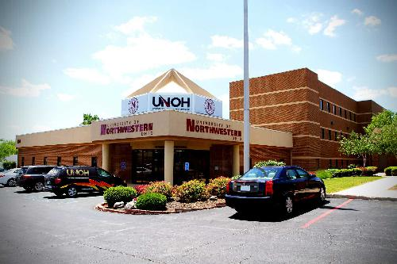

4-year private non-for-profit institution
Lisa
Clark

Slide 14
Policies are institutionally set based on
those commonly used in large online institutions
Communication responses in e-mail and General Questions Forum
Grading response time
Pros
Students: receive timely feedback
Faculty: Consistent time management
Cons
Requires oversight to ensure follow through- leads to delivery concerns
Doesn’t help with weekend warriors

Slide 15
Example 1
Response time: When can students expect to receive an answer to questions?
The instructor will answer questions within 48 hours when posted in the "General Questions" forum. The instructor will answer student emails within 48 hours.
Office Hours: When can I talk with my instructor?
All faculty are required to keep a minimum of one office hour per week in Collaborate. See professor announcements for office hours weekly.

Slide 16
Example 2
Grades: When can students expect to see grades?
All work will be graded within 7 days after the due date

Slide 17
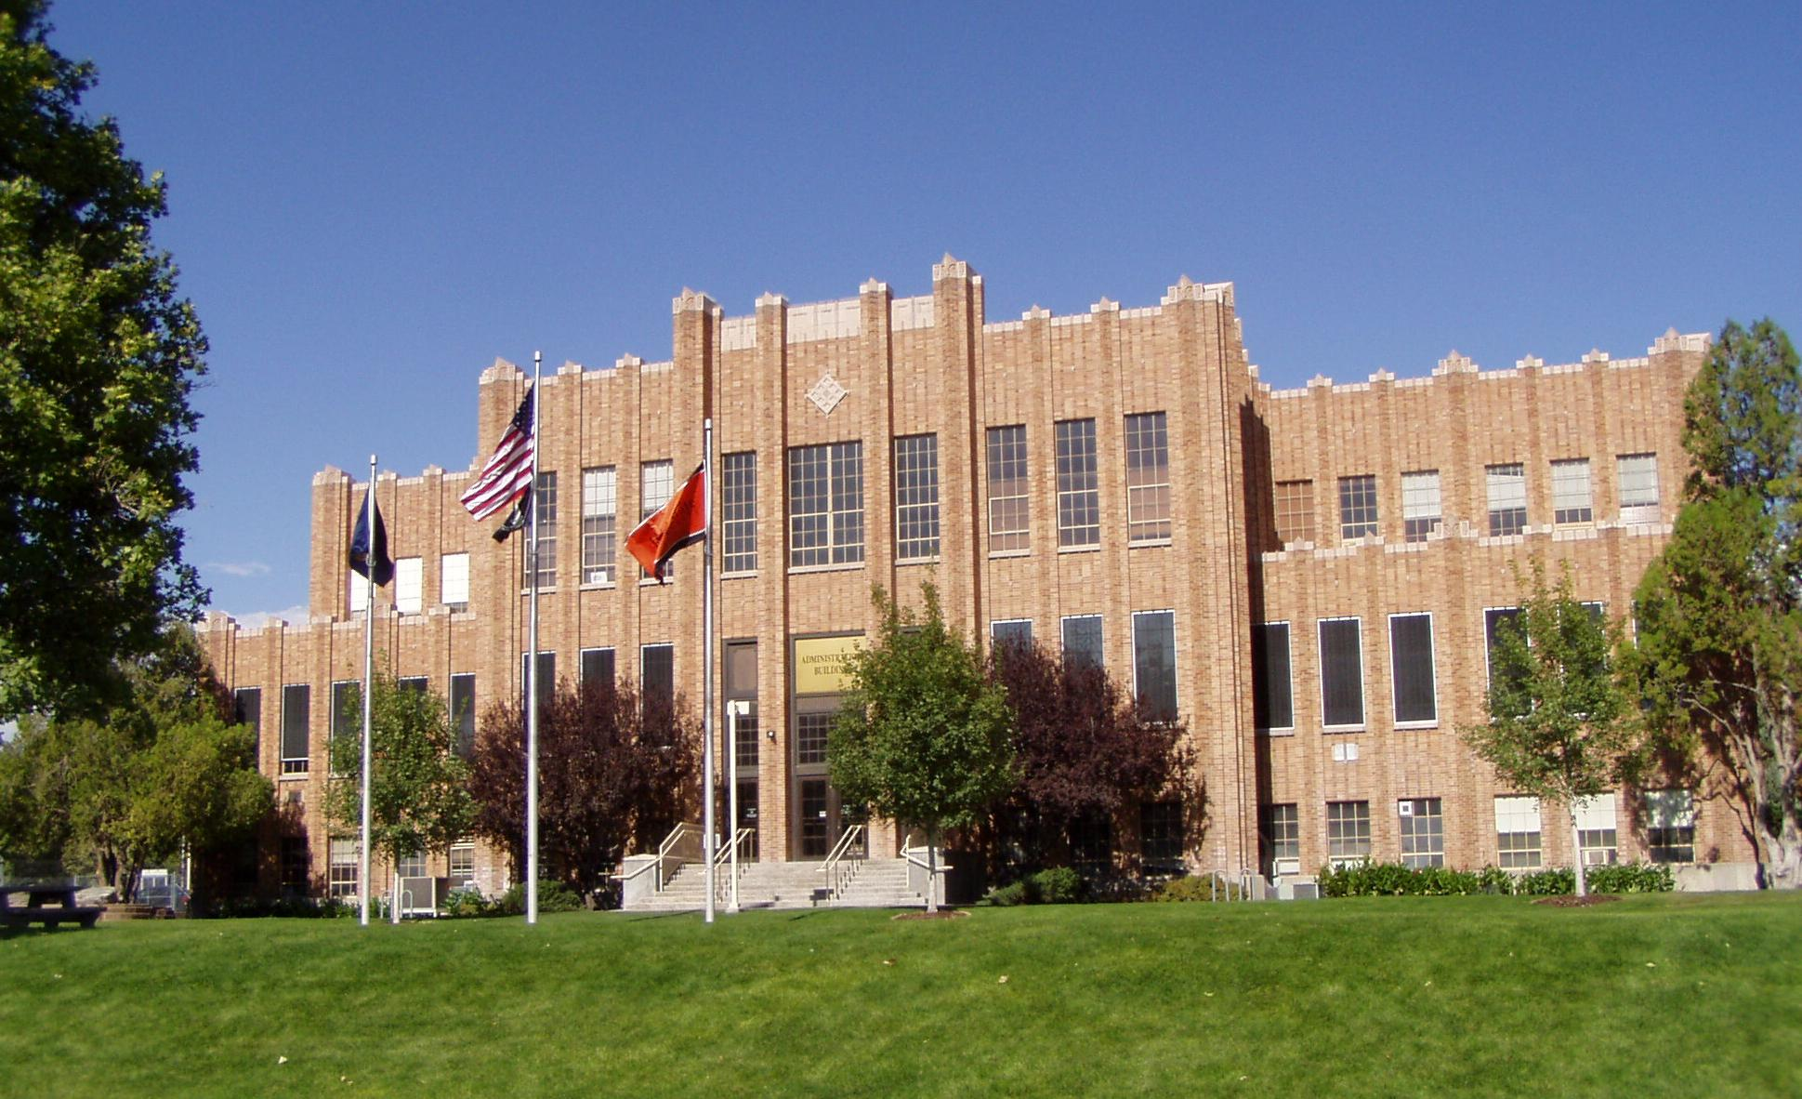

4-year public institution without a collective bargaining agreement
Lisa
Kidder
Notes:
13,000 students
250 programs - certificates through Doctorate degrees
20 degree programs online, 12 graduate

Slide 18
Policies Must Be Present
Email responses
Grading response time
Pros
Faculty By-In
Flexibility
Cons
Variation
Often only addresses one aspect

Slide 19
Example 1
English 1101
Grading Timelines:
Grading will normally take place on Tuesdays and Thursdays, usually in the morning. Due to other professional responsibilities I have, there might be times in which an assignment you have submitted is not graded immediately on the next normal grading day. However, I will make every effort to keep up with grading in a timely manner. If you need something graded in a more timely manner, you are welcome to schedule a visit to my office and I would be happy to review any work you need me to.

Slide 20
Example 2
Nutrition 1139
Response Time Policy:
Mondays I am unavailable most of the day, otherwise I will typically respond to course emails within 48 hours. Grades for assignments will be posted to Moodle within one week after due date. I will be monitoring the class forum discussions and will be posting summary comments after the discussion has ended.

Slide 21
Quality Talks
Specific Review Standard 5.3
Please complete your session evaluations
8th Annual Conference on Quality Assurance in Online Learning, "Blazing New Trails"

