Slide 1
Mastering Elearning:
One Faculty Group’s Experience
Dr. Debbie Beaudry
Dr. Melissa Parks
Dr. Judy Somers

Slide 2
Objectives
Review research about current models for helping faculty move to online learning
Identify the benefits and challenges of a collaborative course development process
Utilize a concept map to demonstrate the different approaches to curriculum between face-to-face and online environments.

Slide 3

Introductions
Debbie Beaudry, Ph.D.
  Adjunct faculty & instructional designer
Melissa Parks, Ph.D.
  Adjunct faculty & classroom teacher
Judy Somers, Ed.D.
  Adjunct faculty & AIT Mentor

Slide 4

Introductions
Where are you from?
What is your role?
What is your experience with online education?
Notes:
I added this slide to get some basic info about who the audience is. How we do it will depend on the numbers. What other info would help us?

Slide 5
Context: What?
Create a series of five high-quality online master’s degree education courses

Slide 6

Context: How?
eLearning Designer/Facilitator Certification Course
Recognized by Quality Matters

Slide 7
Context: When
April 2013
January 2013
6 Units- 12 weeks
3 full days face-to-face
12 hours a week online
168 hours total

Slide 8
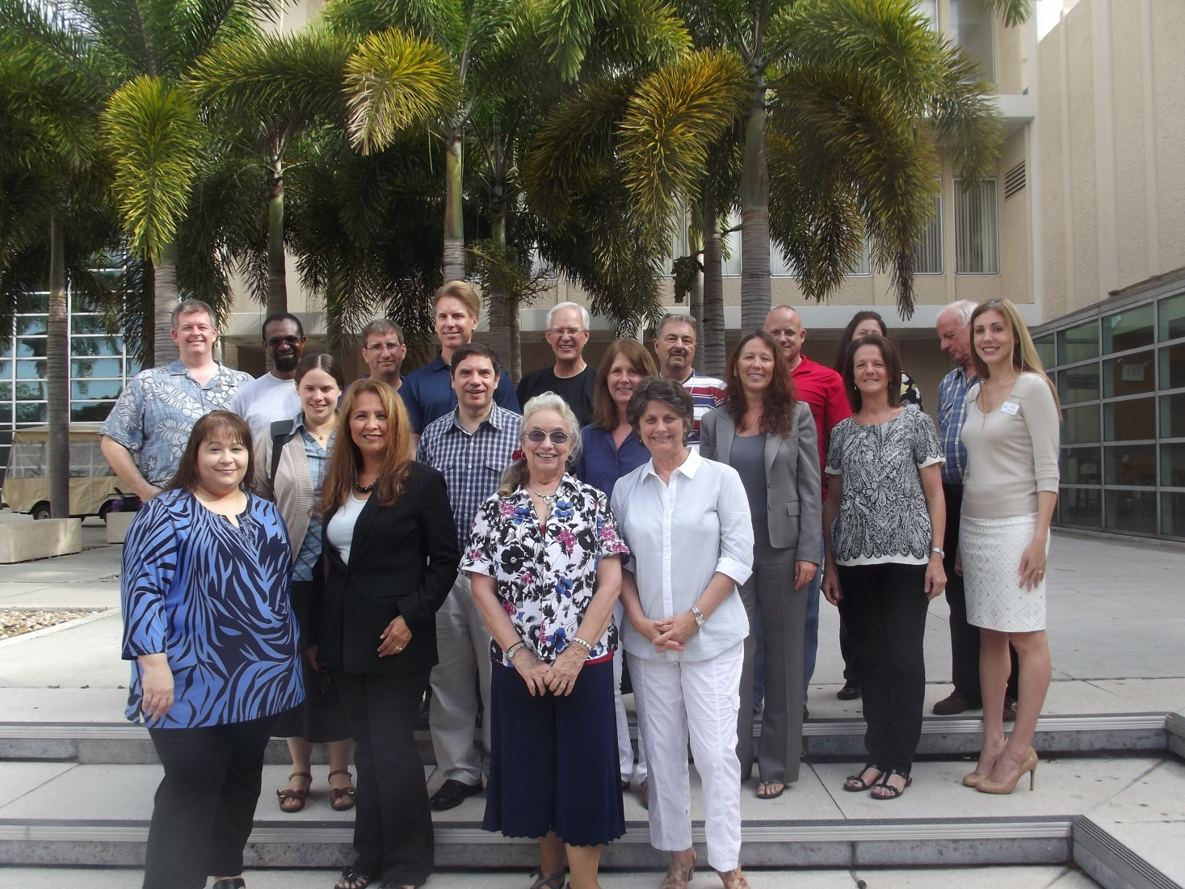
Context: Who

Slide 9
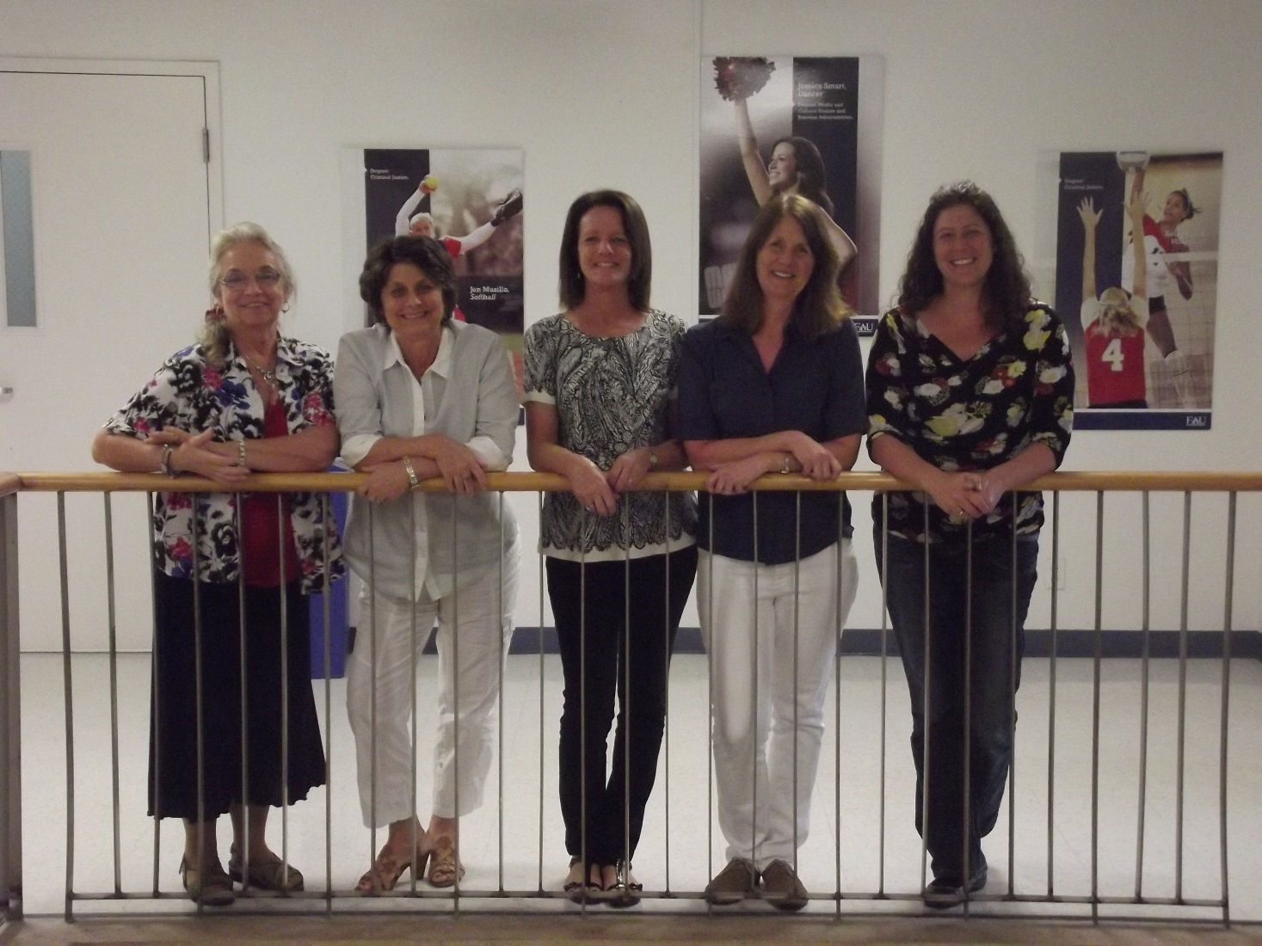
Context: Who

Slide 10
Review of Current Programs
Delivery mode
Duration
Audience
Content/Focus
Incentives

Slide 11
Delivery Mode
Face-to-face workshops
Online
Combination
Instructional design consultation
Self-study
Work with faculty mentor/observe a course

Slide 12
Duration
3-6 hours
8 weeks
3 full days
12 weeks

Slide 13
Audience
Inexperienced online instructors
Experienced online instructors
Full time faculty
Adjunct faculty

Slide 14

Content/Focus
Course design
Technology
How to teach online

Slide 15
Incentives
Stipends
Certificates
Equipment

Slide 16
Procrastinators, Hitchhikers & Overachievers
That’s not due until next week. I’ll do it later.
Oh no! It’s due already! Let me see what everyone has done.
Our cohort
Oh that…I’ve had that done for a week.
Notes:
We all entered the CEL course with a various backgrounds & responsibilities. We were united as a cohort in that we shared the goal of creating 1 of a series of 5 education courses for Masters students. Our various responsibilities forced us to find ourselves in one of these positions on a regular basis.

Slide 17
Vertically Aligned Courses
Action Research
Documentation and Assessment in C & I (elective)
Design Components of Curriculum
U.S. Curricular
Trends and Issues
Curriculum Leadership

Slide 18

Course Commonalities
Sandbox
Start Here (instructor/course information)
Course Content (learning units)
Discussion Boards
Library and Course Resources (external support)
Icons to be consistent

Slide 19

Benefits of the cohort experience
Many ideas grow better when transplanted into another mind than the one where they sprang up. —Oliver Wendell Holmes
Collaboration
  Support, encouragement & commiseration
Image: www.everydayhealth.com

Slide 20

Challenges of the cohort experience
Judgment
Keeping up
  Document production
  Tests
  Discussion boards
  Isolation- comments go ‘out there’ without instant response (McInnerney & Roberts, 2004)
Image:http://www.burokoos.com/blog/wp-content/uploads/2010/02/pressurecooker.jpg

Slide 21

Suggestions & Hindsight
Use the cohort meaningfully: Focus on goals, trust expertise of colleagues, and accept frustrations
  Build and share courses collaboratively
  Discuss shortcomings and pleasant surprises
The secret is to gang up on the problem, rather than each other. —Thomas Stallkamp

Slide 22
Overall take away
Image:
Guidance & support to produce rigorous, engaging, and ‘complete’ online course from face to face course
Cohort
network
Confidence to continue exploring Elearning.

Slide 23
Pedagogical Shift:
Converting F2F Online
Conscious decision?
What’s the BIG deal?
How to incorporate effective teaching practices?
What about interactive discussions?
How do I know who they are?
What’s important to incorporate?
“All I need to do is add my PPTs, insert some Web links for them, include some Discussion Board questions and some MC quizzes and…VOILA! An online course, ready to go…”
Notes:
Obviously, attendees are/have converted with intent. We will focus on the ‘How’s’ and successes of effective conversion.

Slide 24

LMS
Effective Tool
Ways to engage & interact; online or F2F
Repository for Course
LINK between students & instructor
Notes:
Basic comments about LMS: Blackboard, Moodle,… how they are used for F2F, effectiveness for transition to eLearning

Slide 25
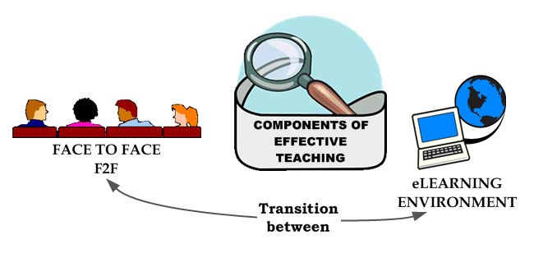
Components of an Engaging Environment
Notes:
Generate responses about what components are available to create engagement in eLearning

Slide 26
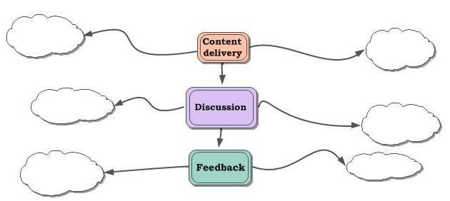

Slide 27
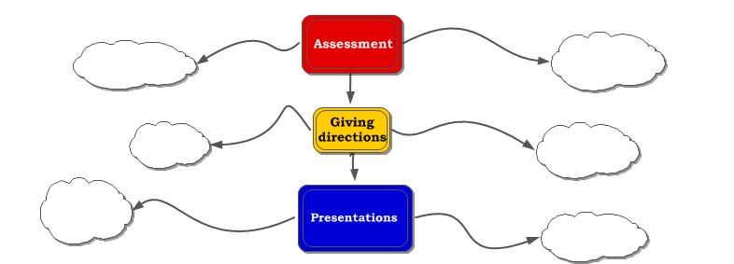

Slide 28
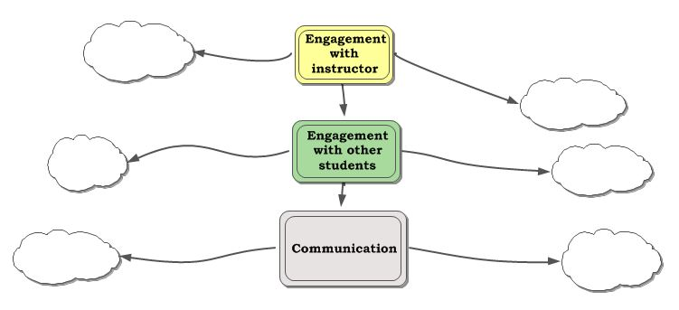

Slide 29
Online Excellence
Factors:
Student:
Sound pedagogy
Effective and engaging learning environment
Meaningful learning experiences
High student satisfaction
Medium becomes transparent
Focus on course
Immerse in learning experience
Groups, activities place student in charge of learning
Construct own understanding
Henry, 2008

Slide 30
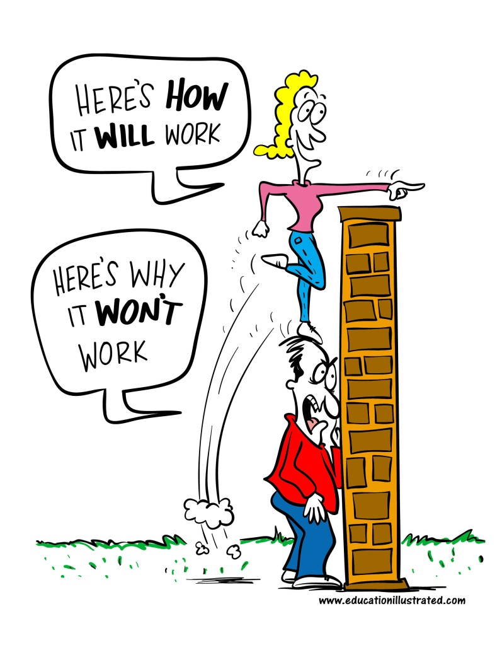
Online: Totally different environment
Unique strengths and capabilities available
Retooling, redesigning course materials
Course prep- time consuming
Active student involvement with content
Interaction, dialogue, coaching

Slide 31
“Great online courses are defined by teaching, not technology.”
Henry, 2008
All aspects of course align with objectives
Sense of community: collaborative learning activities, communication, social presence (doesn’t happen on its own)
Support throughout
Ongoing assessment, evaluation, revision

Slide 32

Extras that make a difference
E-mail & announcements
Audio, video
Additional resources
Personal connections

Slide 33
Survey Data
Padlet:
High points: I enjoyed opportunity to "stir the pot" with peers re: collegial issues; prof handled technology with mastery: she integrated it into learning and I came out more proficient; I came into the course skeptical about the quality of online courses and came out a proponent; this was thanks to the prof's instructional tech proficiency
Surprised by: The quality of the learning experience in an online environment.
Professor’s proficiency with instructional technology to a greater extent than I've experienced. Your fundamental tools of the trade pretty much weren't around even 5 years ago... Nice. I'm learning lots.

Slide 34


