Slide 1
The Ultimate Oxymoron:
Welcome to
Teaching Speech Online
Quality Matters Conference
San Antonio, TX
November 3, 2015
Notes:
Howdy! I’m excited to be here in San Antonio for the 2015 Quality Matters conference, and I’m very happy you chose to attend my session. I’m also just a bit terrified. You see, I like to talk, I enjoy teaching, and I love to talk about teaching; but this session is only supposed to run for 25 minutes, including time for you to interact with each other and to ask questions. With that being said, let’s get started! “Welcome to The Ultimate Oxymoron.” [CLICK]

Slide 2
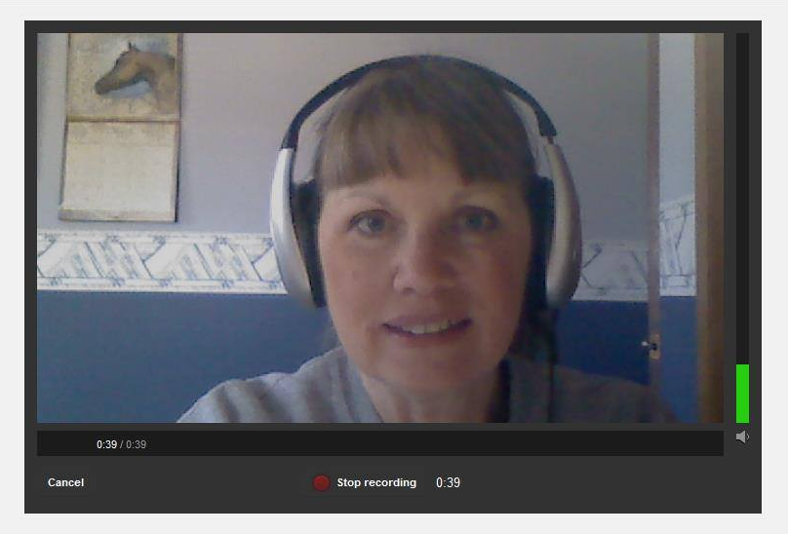
Welcome to
Presented by
Patti Huber, Instructor
Department of Communication & Performing Arts
Madison Area Technical College
Madison, WI
Notes:
My name is Patti Huber, and I am a full-time instructor with the Communication & Performing Arts Department at Madison Area Technical College (aka Madison College).
I have a Master of Science in Teaching degree from UW-Platteville, with majors in Speech and English.
The first time I walked into a classroom as “the teacher,” was in 1973, and I was a graduate teaching assistant.
Altogether, I have roughly 35 years of teaching experience; I’ve taught students from 5th grade through college, but I’ve been at Madison College for 16 years.
In 2007, I developed the first online speech course at Madison College.
In 2011, I developed the first hybrid speech course at Madison College.
In 2014, I was the first instructor at the college to complete a formal Quality Matters review.
And … [CLICK]

Slide 3


Notes:
… I consider myself to be somewhat of a dinosaur or novice (take your pick) when it comes to technology. [CLICK]

Slide 4
oxymoron
ox·y·mo·ron
noun \ˌäk-sē-ˈmȯr-ˌän\ :
a combination of words that have opposite or very different meanings
Notes:
When I was first approached about creating and teaching an online speech course in 2007, the idea seemed like the ultimate oxymoron. There are certainly problems and pitfalls, but teaching speech online CAN be done – and done successfully. Like teaching in a traditional face-to-face classroom, to succeed requires preparation, organization, and attention to details – all factors that are addressed by Quality Matters. To succeed also may involve an inordinate amount of patience and perseverance since technology does not always cooperate as well as we might expect. [CLICK]

Slide 5

My Survivor’s Tale
Notes:
This session is – for the most part – a personal narrative, my “survivor’s tale,” about the creation and evolution of my online speech class at Madison College. Before I get into my story, however, want to take just a few minutes to “set the stage,” to get everyone thinking about traditional face-to-face speech instruction, and then I’ll show you how my online speech class is structured. [CLICK]

Slide 6

QM General Standard 2:
LEARNING OBJECTIVES
(Competencies)
Notes:
I believe we’re all familiar with QM General Standard #2 regarding Learning Objectives. In case you’re new to QM, Learning Objectives, also called Competencies, should serve as the basis for everything we do in our classes. For this conference session, I have three Learning Objectives. [CLICK]

Slide 7




Learning Objective 1:
Recall your college speech class.
Notes:
I’ll give you just a minute or so to think about your college-level speech class.
Of course, I’m assuming that you took a speech class. Some students avoid public speaking like the Plague; some have even been known to change majors to avoid taking a required speech class. Here are three basic questions to consider:
1. Did you ever take a college-level public speaking class?
2. How was the class presented/conducted?
3. What was that learning experience like for you? Are you reminded of yourself by any of the photos on the screen? [CLICK]

Slide 8
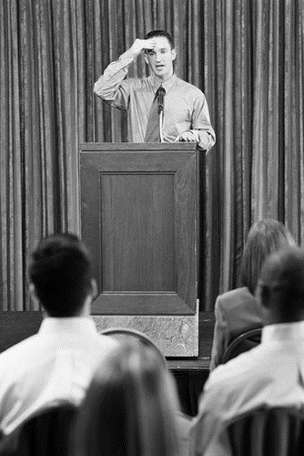




Learning Objective 2:
Compare/contrast your experiences.
Notes:
Now please “pick a partner” or work in small groups of three but no more than four to discuss and compare/contrast your experiences when taking college-level speech. In the interest of time, we’ll only take a few minutes for this. [PAUSE … CLICK]

Slide 9


Notes:
Now that you’ve had a chance to compare and contrast your apples and oranges experiences pertaining to speech class, it’s time for me to share how I was given an opportunity to make lemonade from lemons. In other words, it’s time to share the story of how I was recruited to develop the first 100% online speech class at Madison Area Technical College. [CLICK]

Slide 10


Once upon a time, many monitors ago …
Notes:
As I mentioned earlier, the course was first taught in 2007. That spring, I was approached by instructors from the Business Department and asked if I would be willing to develop an ONLINE SPEECH CLASS for students enrolled in the otherwise 100% online Administrative Assistants program, which is now referred to as the Administrative Professionals Program. Although my department (Communication and Performing Arts) is part of the School of Arts and Science, the Business Department is within the School of Business and Applied Arts. Each school has its own Dean, so the “big” question was not what an online speech class should look like or how it might be implemented, but rather who was going to pay me to develop the course. Since the program was being established specifically for students in a program housed within Business and Applied Arts, it was determined that payment for the course development would come from the School of Business and Applied Arts budget. [CLICK]

Slide 11

No turning back!
Notes:
Two instructors from the Business Department, whom I had shared an office with during the spring of 2003, had recommended me for the challenge. These same two instructors who, who were tech savvy and who were already teaching online classes, assured me that I would have no problems converting my speech class to the online format. The real “catch” to all of this, however, was that I had never even logged into Blackboard. I didn’t have any need to do so! When I brought fact to the attention of one of my Business Department buddies, her response was, “That’s not a problem. Just get your lectures and assignments ready and a couple weeks before the fall semester you can sit down with “so and so” from the Tech Department to upload everything to Blackboard. With virtually (honest - no pun intended) instruction on how I was to proceed, I spent a large portion of the following summer planning and preparing. All of my materials were neatly created using good old Microsoft Word – you know, the files that end with dot doc. [CLICK]

Slide 12
IOTTMCO
intuitively obvious to the most casual observer
Notes:
While others believed that I would somehow intuitively know what to do with the technology, I was far from competent or confident. Let’s just say the learning curve was steep – and dampened with a few tears of frustration. When the tech guru I went to at the beginning of August for help began talking about converting my lectures and handouts to something called “HTML,” I nearly had a meltdown on the spot. Obviously, I’m HERE today talking about my online speech class, so I’ll cut to the chase: The friend who said, “Just get your lectures and assignments ready …” calmly sat down with me, assured me that I did NOT have to know anything about HTML (I still don’t, in fact), and showed me the simple steps to upload my Word documents into Blackboard. [CLICK]

Slide 13
That was then … and this is now.
Internet access
Textbook
4 VHS tapes
Video camera
Writing materials
Live audience
Positive attitude
Internet access
Textbook
YouTube account
Digital camera
Writing materials
Live audience
Positive attitude
Notes:
Some components of the course have changed, but for the most part the class is still very much the same now as it was eight (8) years ago. In fact, it’s essentially the same content-wise as the face-to-face public speaking course that I taught several decades ago. Changing the method of delivery doesn’t necessarily change the material being presented and learned. “Changes” to my online class from when it started until now are highlighted by red print. [CLICK]

Slide 14
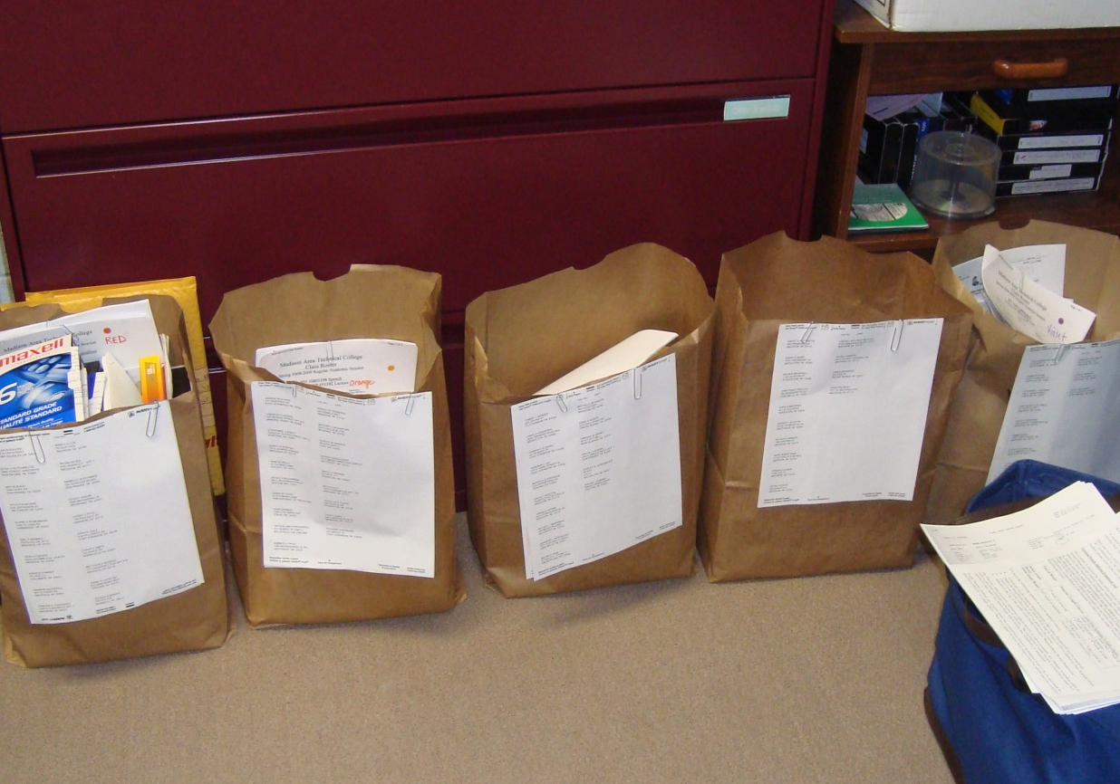
Before YouTube students used VHS tapes!
Notes:
When I first began teaching online speech, many friends and colleagues said it must be “easier” to “just sit at home on the computer” than to travel to campus to meet with students face-to-face. For anyone who believes this is true, I would invite them to walk a mile in my shoes (or sit for a 12-hour stretch at my desk). Anyone who teaches online knows that the majority of online learners think their teachers should be available 24/7. This circa 2009 photo shows video-taped speech submissions, sorted by class section, that lined my office floor. Students made recordings of their speeches and then sent them to me via USPS, UPS or FedEx. This photo shows just one round of speeches. I was thrilled when PhotoBucket and YouTube came along; and I’m excited about all the additional video capture options (such as Screencastomatic and My Media Site) that are available today. The only drawback to all of the innovations is finding the TIME to learn to use them. Never-the-less, I believe it’s worth the effort it takes to at least review and update our classes on a regular basis. That belief is a major factor in why I chose to put my online speech class through a formal Quality Matters review. Going through the process made my “good” class “better.” [CLICK]

Slide 15

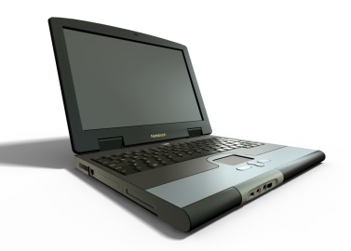
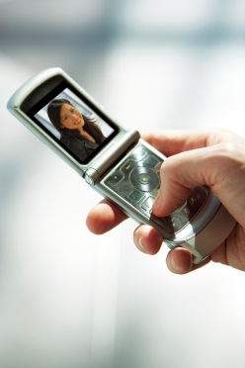
That was then … and this is now.
Notes:
I think it’s worthwhile to note: While technology has evolved, I believe the amount of time and effort involved has remained about the same for both the students and myself. [CLICK]

Slide 16

Check the details.
Notes:
I tend to be a “big picture thinker,” (at least according to personality surveys), but teaching online requires some hard core attention to details. [CLICK]

Slide 17
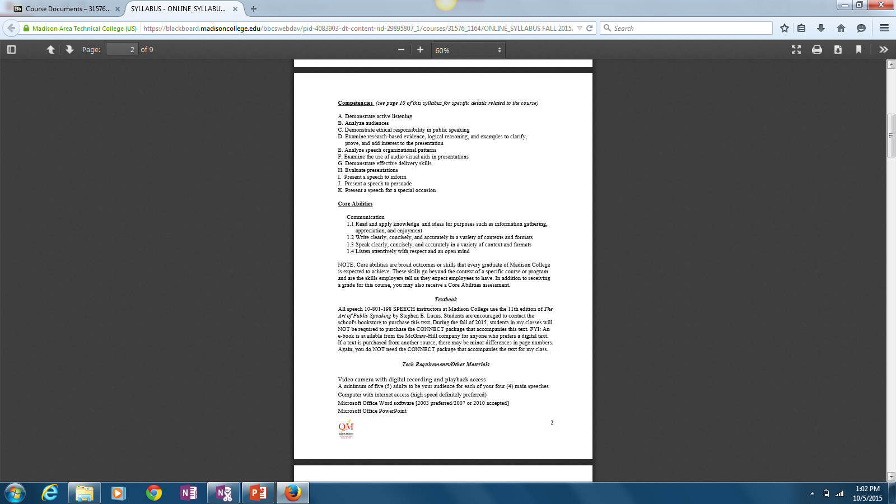
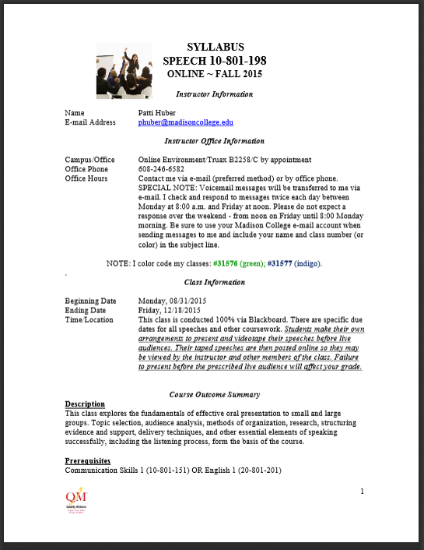
Notes:
Those “details” can be found the course syllabus. Providing a syllabus that students can understand and follow is critical to their success in any class, but I think it’s especially vital for an online course. After decades of teaching, and after having undergone a formal QM review, I believe my syllabus is in pretty good shape. In fact, I’m confident enough about it that I’ve brought copies to share with you today. [CLICK]

Slide 18


Course Navigation
Greetings!
Please watch this JING video http://screencast.com/t/Wpzijniub0 with information about navigating my speech class on Blackboard. [You may need to copy/paste the link into your browser.] The video runs just under 4 1/2 minutes. You should be able to log into the course on Blackboard and access preliminary information on Monday, August 24.
Best wishes,
Patti Huber
Notes:
Along with having a solid syllabus, it’s helpful to provide students with information about how to navigate an online course. Before the start of the fall 2015 semester, I sent the message shown on the left side of the screen to students enrolled in my speech classes. The message contains the URL for a JING video. [CLICK on the LINK to play the video.] http://screencast.com/t/Wpzijniub0 [CLICK]

Slide 19
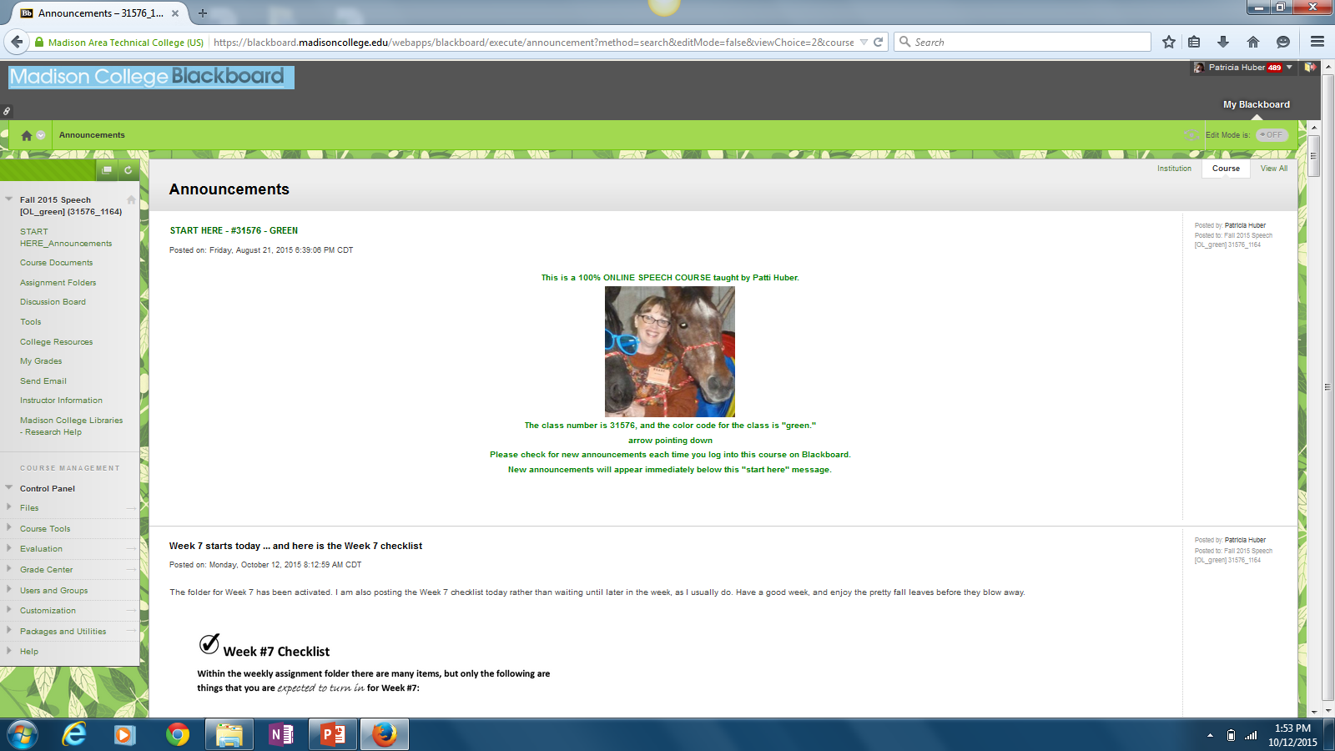
Notes:
I realize that you can’t clearly see the information on this slide, but you CAN see is the overall layout of the page. I like to include personal photos and as well as other graphics. I also use quite a bit of white space. As you may recall from the JING video, this is the top or the Announcements page students will see each time they log into the course. This “banner” remains the same all semester. [CLICK]

Slide 20
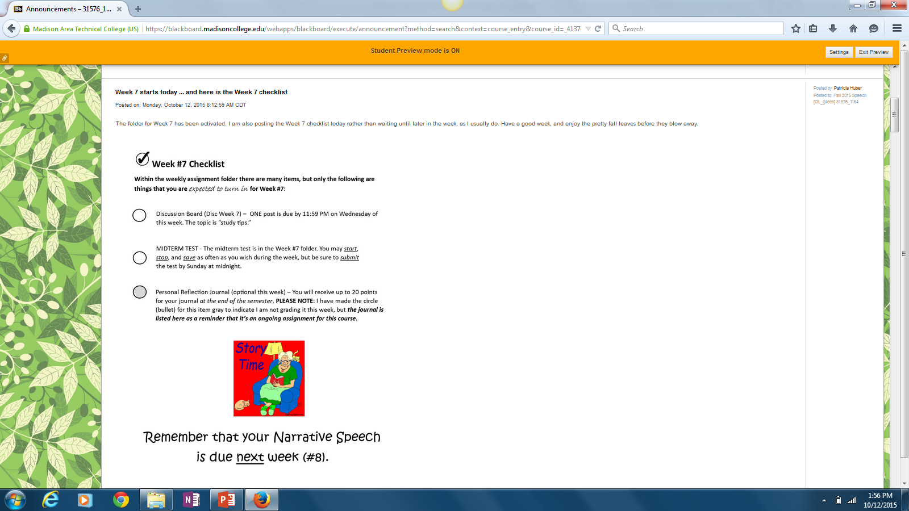
Notes:
Below the announcements banner are the announcements. Each week I provide a CHECKLIST of assignments that are due. This is the Week #7 checklist. The checklist is also emailed to students. [CLICK]

Slide 21
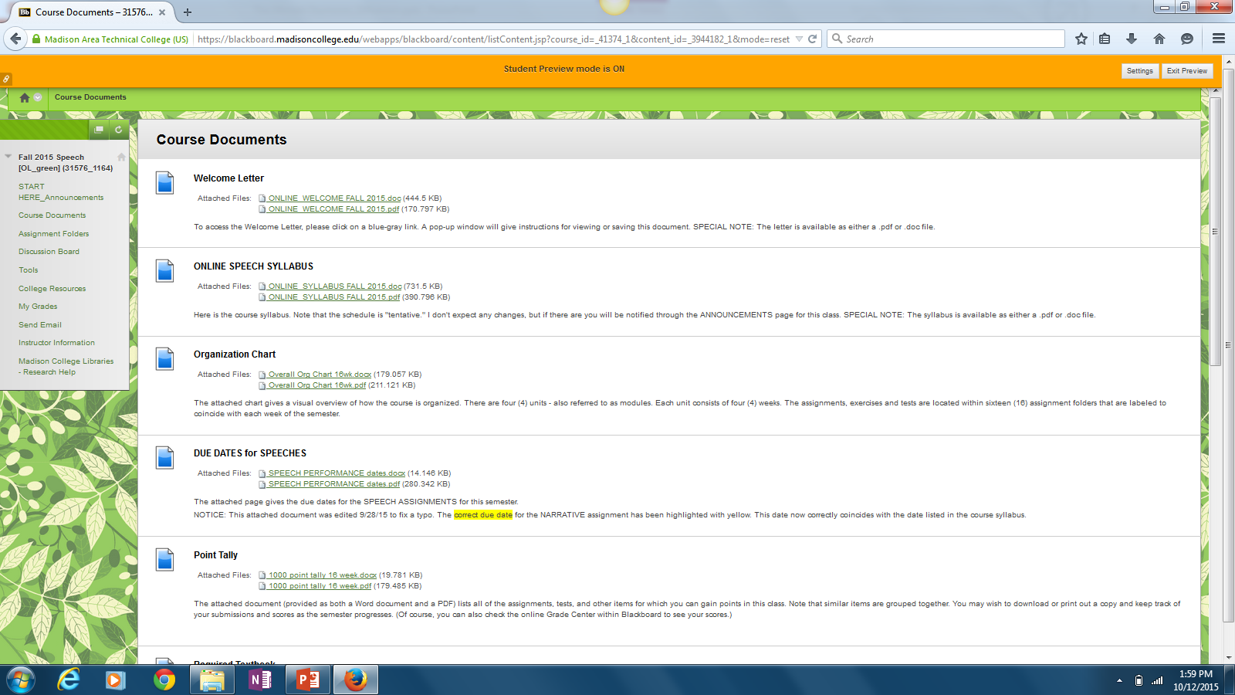
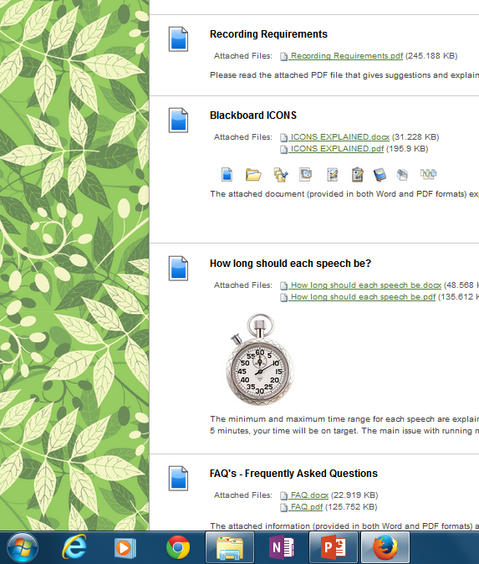
Notes:
This shot shows the Course Documents screen cut into 2 segments. Within the Course Documents file, there are a couple items students have found helpful. [CLICK]

Slide 22
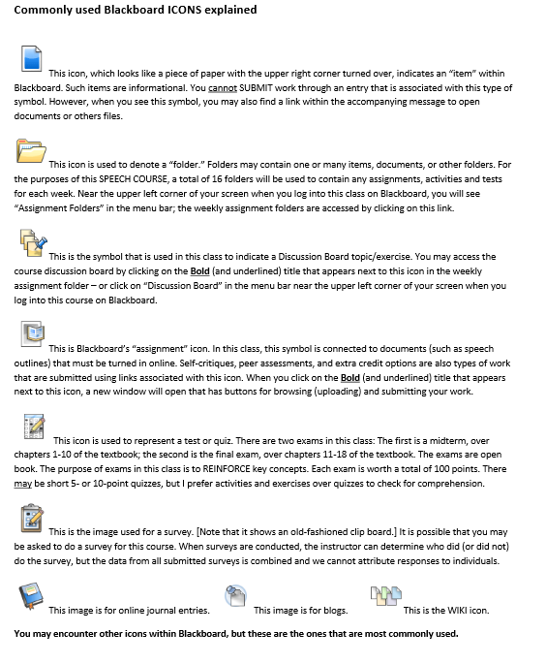
Notes:
One of those items is a list of commonly used Blackboard ICONS with a description of each. I have a handout of this page to share with you today. [CLICK]

Slide 23
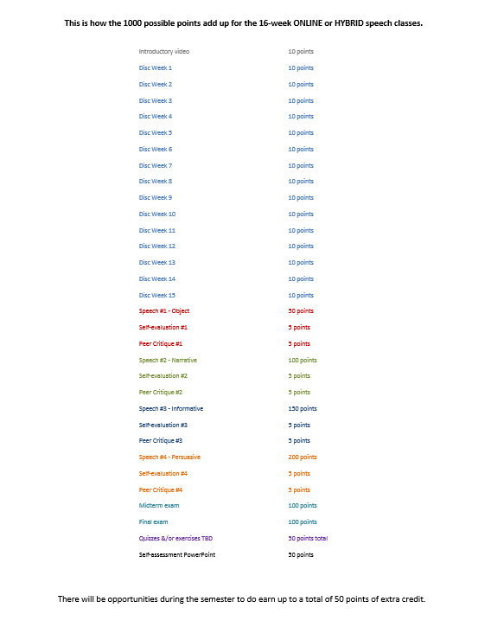
The course is based on 1000 points
Notes:
Another item students like is a list of all the assignments and their point values. I also brought copies of this page to share with you today. [CLICK]

Slide 24
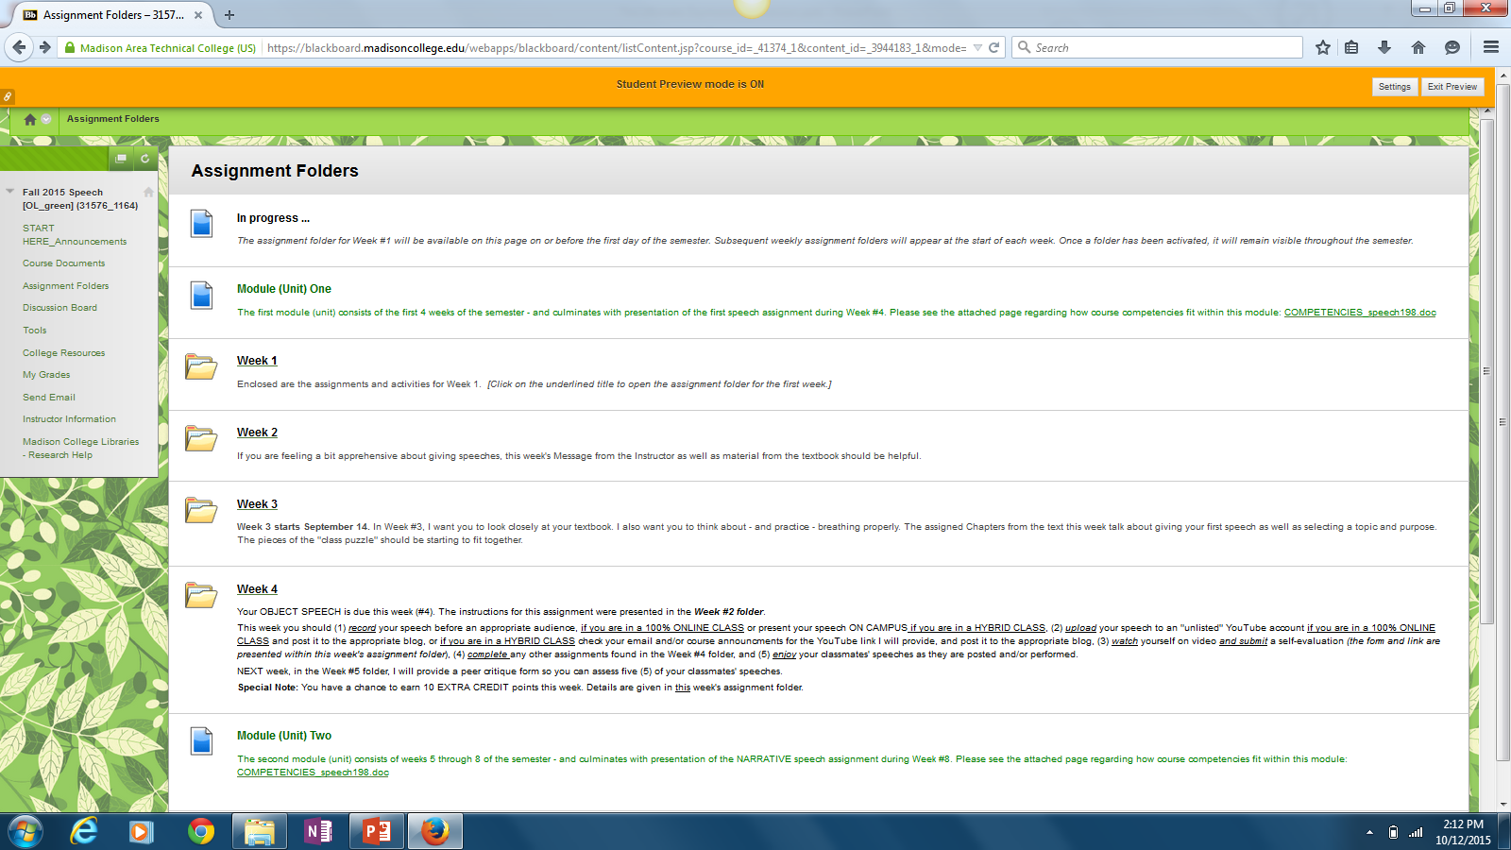
Notes:
I post a new assignment folder at the start of each week. I never remove the folders. This screen shot just shows a note about the page being “in progress” at the top, followed by a description of what will be covered in Module (Unit) One, and then the folders for Weeks 1 through 4. At the bottom of the image is the description for Module (Unit) Two. Something to note is that with each module description, I include a hot link to the COURSE COMPETENCIES. While I’m pretty sure only a small handful of students actually look at the competencies, they are available for those who do want or need to see them. [CLICK]

Slide 25
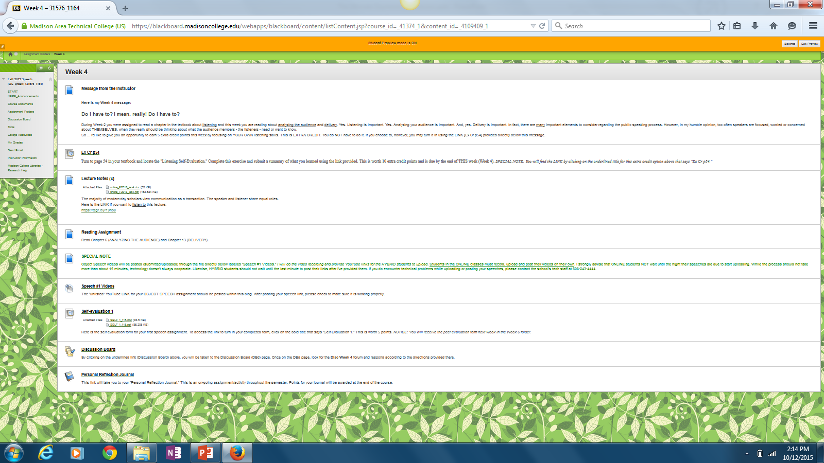
Notes:
This shows the contents of the Week 4 assignment folder. I try to keep items in the same basic order each week, beginning with a Message from the Instructor and ending with the Personal Reflection Journal. [CLICK]

Slide 26
Notes:
Here’s a close-up of the assignment headings from the Week 4 folder. You may (or may not) be able to tell from the image on the screen, but I always provide documents as both Word and PDF files. I also provide my lectures as audio files in addition to the document versions. [CLICK]

Slide 27
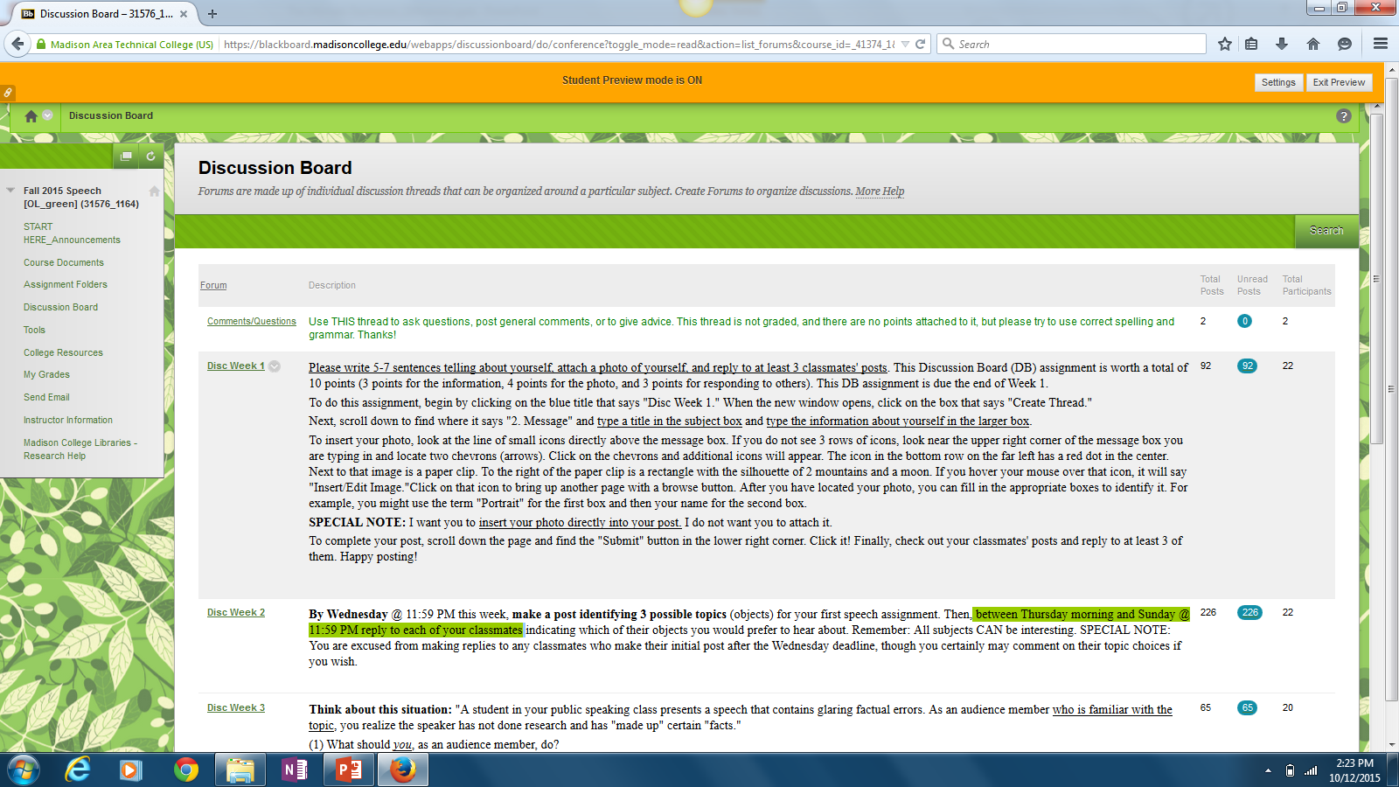
Notes:
Another constant within the course is the Discussion Board. The topics reinforce concepts that pertain to their speech assignments. I occasionally chime in with comments but for the most part I simply “lurk” and monitor. I’ve found the less I say/interfere, the more likely students will be to share their ideas and not worry about providing the answer they think I want to hear. Within the instructions, I will sometimes remind students to “be respectful” or to “be rhetorically sensitive” with their comments. I’ve been impressed with how they have been able to politely disagree with each other. Sometimes they even acknowledge that they can understand the other person’s point of view. [CLICK]

Slide 28




Online Speech: My perspective
Notes:
The basic content is pretty much the same in my speech classes now as it was 20 years ago, and 21st century speech students are pretty much the same, too. They come into the course worried about how they will be perceived by their audience. They come into the course with varying levels of communication apprehension. They come into the course with different levels of writing ability and their delivery skills vary. Truly, from my perspective, the only BIG difference between “then” and “now” is the method of delivery. The technology allows us to reach students we could not have reached before.

Slide 29



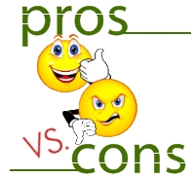

Learning Objective 3:
Discuss the pros & cons of OL vs F2F.
Notes:
Today you recalled your own college-level speech class experiences, and then you compared your experience with others. After that, I shared my story and an overview of my online course with you. At this point, it’s time to tackle Learning Objective 3: It’s time for you to discuss the pros and cons of OL vs F2F speech. What do you think? Is an online speech class the ultimate oxymoron?

Slide 30
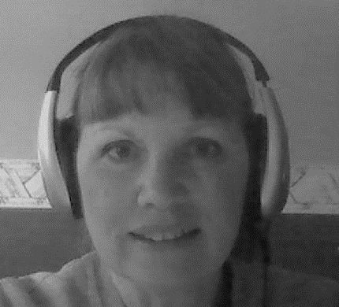
Thank you
for attending my session:
The Ultimate Oxymoron
Teaching Speech Online
phuber@madisoncollege.edu
Notes:
Thank you for attending my Quality Matters session. If you have any questions, I’d be happy to try to answer them now … or by email later. My address is: phuber@madisoncollege.edu.

