Slide 1
Is it Working? Stop Assuming, Start Assessing!
Joanne Dolan
University of Wisconsin - Green Bay
@SlightlyJo

Slide 2
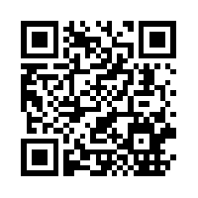
Resources
http://tinyurl.com/QM14SASA

Slide 3
Context

Slide 4
Process

Slide 5
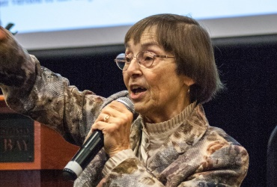
Barbara Walvoord

Slide 6
Process
Questions
Data
Action

Slide 7
Questions

Slide 8
Questions
Has the program impacted how faculty teach?
Has the program improved course design?
Has the program improved student perception of online courses?

Slide 9
Questions
Draft 1-3 questions that you would like to answer about your QM program
Share with your group

Slide 10
Data

Slide 11
Has the program impacted how faculty teach?
Faculty surveys
Pre-Course

Slide 12
From your previous online teaching experience, do you believe that teaching an online course is -
more satisfying than teaching a residential course
equally satisfying as a residential course
less satisfying than teaching a residential course

Slide 13
From your previous online teaching experience, do you believe that the quality of student learning in an online course is -
higher than in residential course
equal to a residential course
lower than in a residential course

Slide 14
 | Very Good | Good | Needs Work | Poor
The course includes measurable course objectives
The course includes measurable module objectives
The course is well-organized and navigation is logical
The course includes varied assessments
The course provides opportunities for interaction and active learning
The course provides students multiple opportunities to measure their learning
The course uses accessible technologies

Slide 15
Has the program impacted how faculty teach?
Faculty surveys
Pre-Course
Post-Course

Slide 16
How do you feel taking part in this course, and working with fellow colleagues, have impacted your teaching and online course design?

Slide 17
For this question, imagine you were not submitting your course to QM.
Which changes discussed over the last two weeks would you still plan to implement in your course?

Slide 18
Has the program impacted how faculty teach?
Faculty surveys
Pre-Course
Post-Course
Post-Review

Slide 19
How did redeveloping your course change the way you teach? Which specific changes most impacted your teaching?

Slide 20
How did redeveloping your course change the way that your students learn? Which specific changes most impacted your students’ learning?

Slide 21
Is there a change that you feel has negatively impacted your teaching, or your students’ learning? Can you tell us more about this concern?

Slide 22
Having completed the redevelopment and review, what do you wish you had known prior to this process?

Slide 23
Has the program impacted how faculty teach?
Faculty surveys
Pre-Course
Post-Course
Post-Review

Slide 24
Has the program improved course design?
Pre-Course QM Rubric Score
Official Review Rubric Score
Non-QM Course Rubric Score
QM Standards Breakdown in MyQM

Slide 25
Has the program improved student perception of online courses?
Student Evaluations

Slide 26
Data
Considering your questions
What data do you already have access to?
What data can you easily obtain?

Slide 27
Action

Slide 28
Action
Refine course to meet faculty needs
Identify support necessary to improve weaker standards
Improve Student Evaluation survey

Slide 29
Other Suggestions

Slide 30
Other Suggestions
QM Research Agenda
Analytics
Face-to-Face Impact
Others?

Slide 31
Resources
http://tinyurl.com/QM14SASA

Slide 32
Is it Working? Stop Assuming, Start Assessing!
Joanne Dolan
University of Wisconsin - Green Bay
@SlightlyJo

