Slide 1
An eLearning Academy Takes Flight: Propelling Our Program Toward Effective Implementation

Slide 2
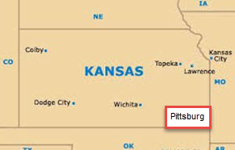
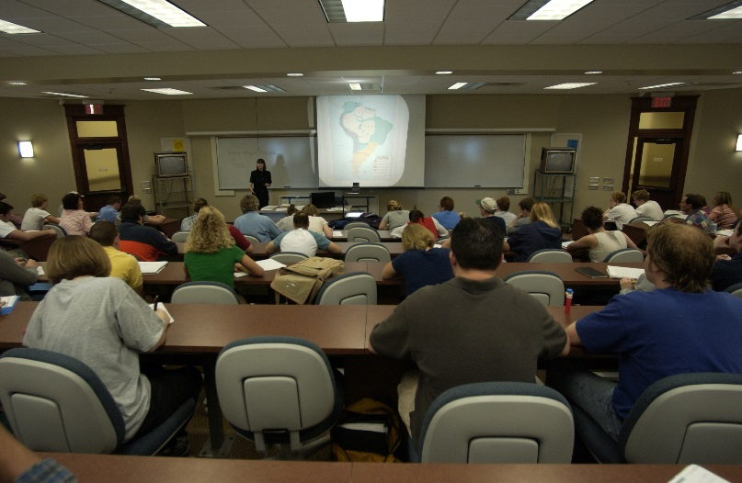
Pittsburg State University
4 Colleges:
A&S, Business, Education, Technology
7,000 Students
320 Full-time Faculty
Bachelor’s, Master’s, EdS, & Doctoral degrees

Slide 3
eLearning Academy Flight Pattern
AASCU’s Red Balloon Project implementation through Academic Affairs
Establishment of Center for Teaching, Learning & Technology
Growth of online delivery of courses
Enhance faculty instructional skills
Assure quality of online courses

Slide 4
Steering Committee
8 members (3 from A&S, 2 from Ed, 2 from Tech, and 1 from Business)
Met during summer 2012 to establish goals, processes, plan of action, and timelines
Recommended using the Quality Matters Rubric
Completed a Quality Matters course on applying the QM Rubric
Completed a Quality Matters course on peer reviewing

Slide 5
Yearly Cohorts
Call for Cohort applications in Spring
Applications processed through review committee
Year long commitment
Attend a required orientation meeting in May
Complete “Applying the QM Rubric” Online Course during the summer
Attend required monthly meetings during fall & spring, including two PD events each semester

Slide 6
APPQMR Course
May - July
1st Course Revision Summer - Oct 1
Cohort Partner Reviews Oct 1 - Oct 31
2nd Course Revision Nov 1 - Jan 1
Official PSU Review Spring Semester

Slide 7
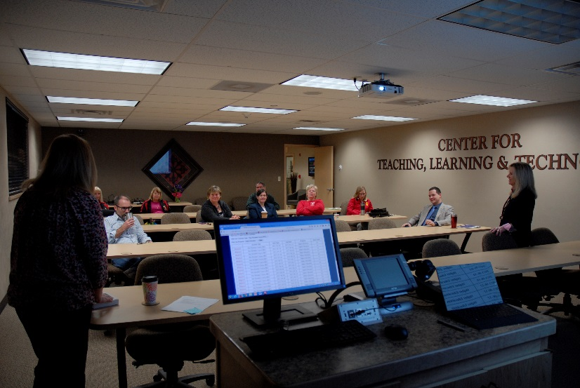
Sustaining the eLearning Academy

Slide 8
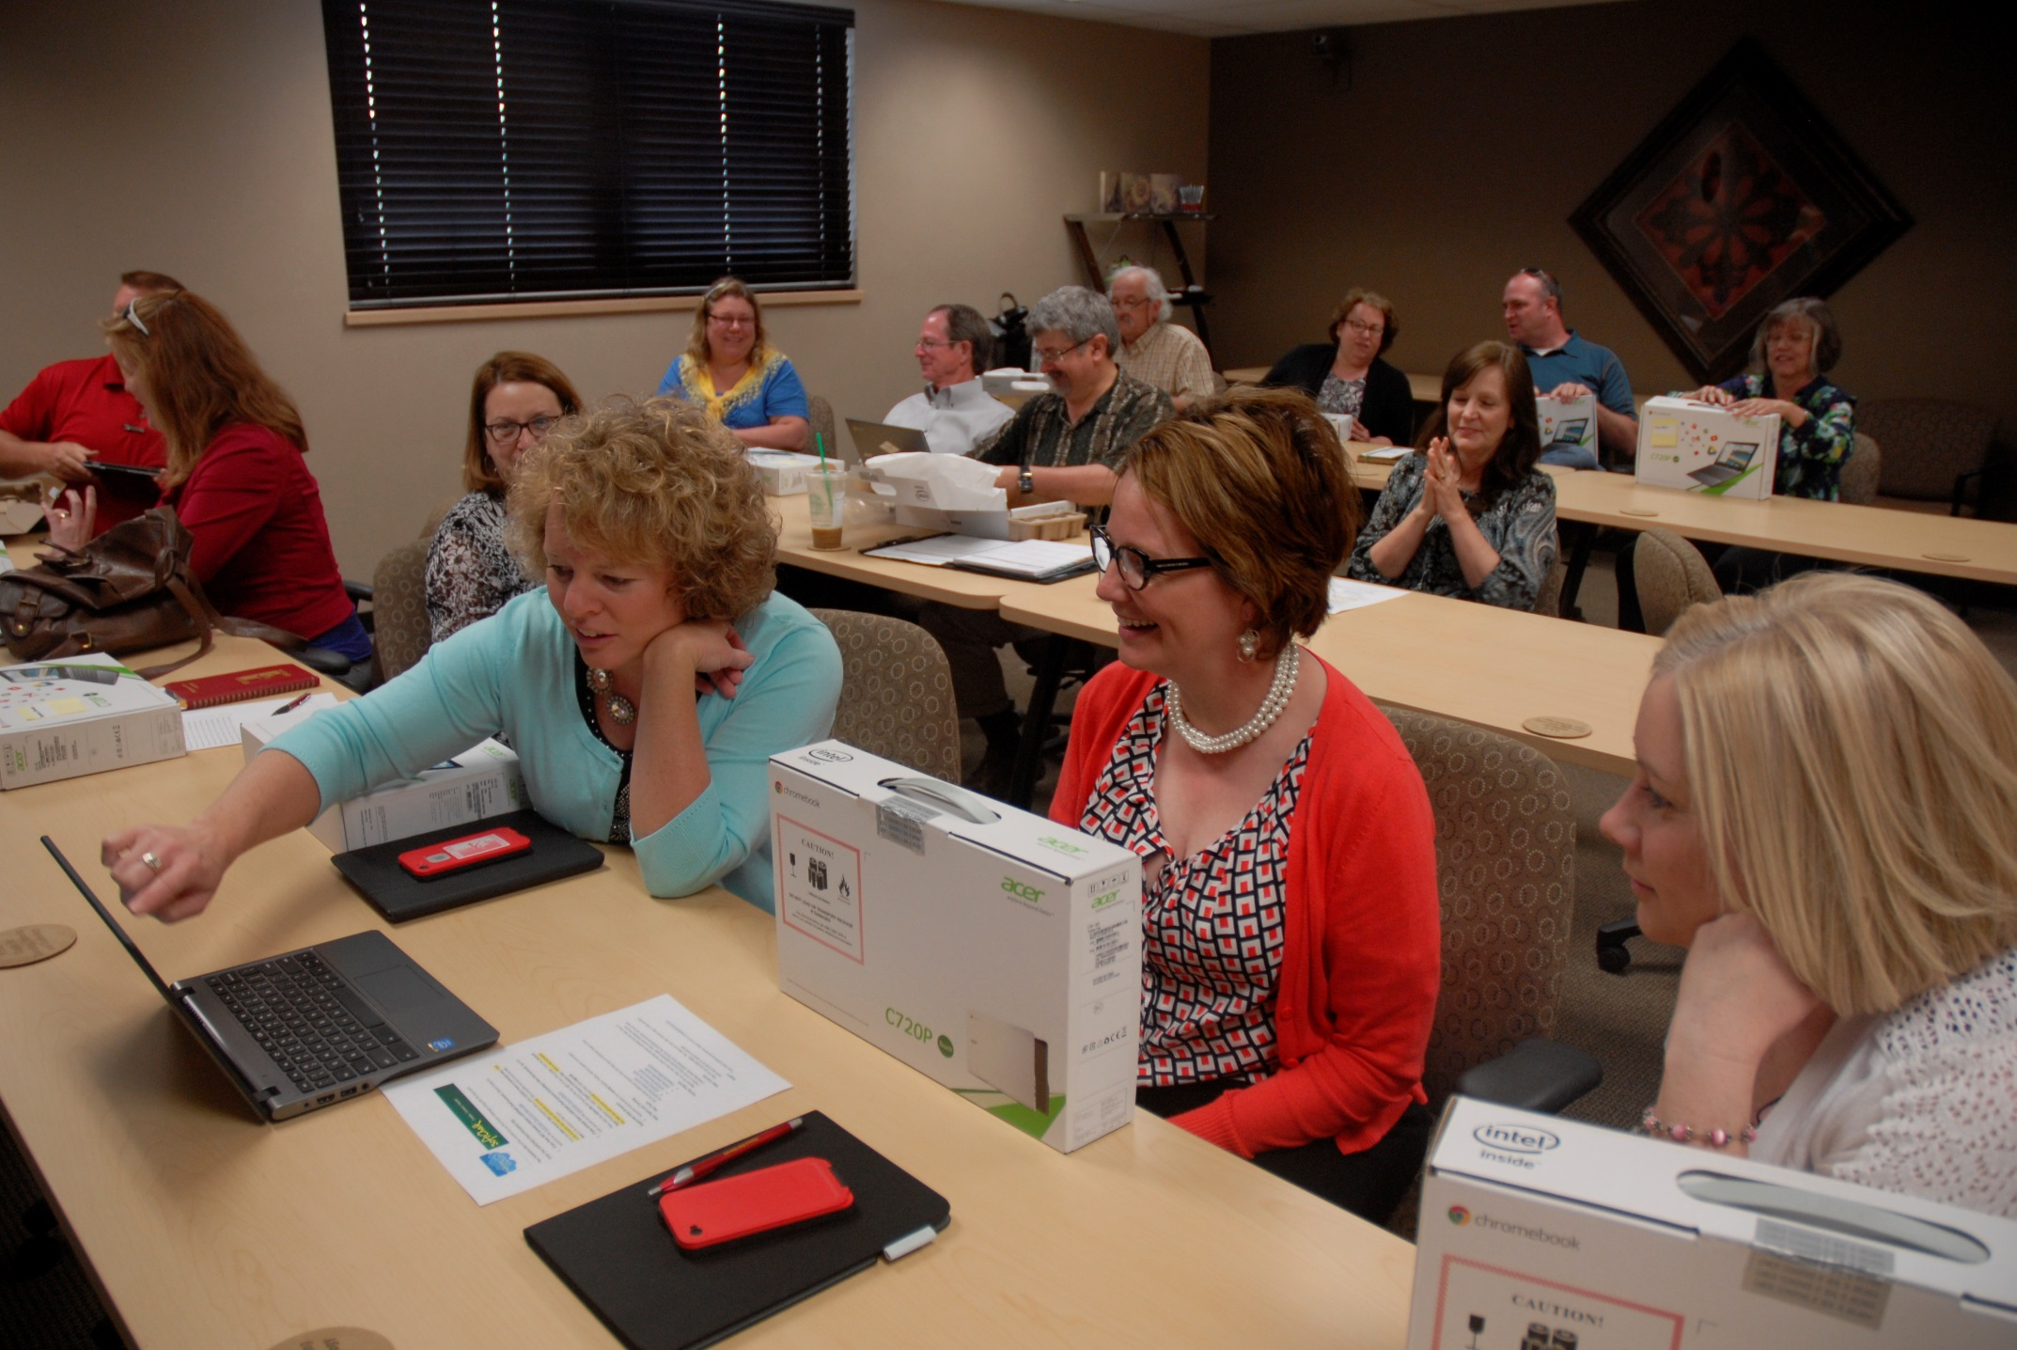

Slide 9
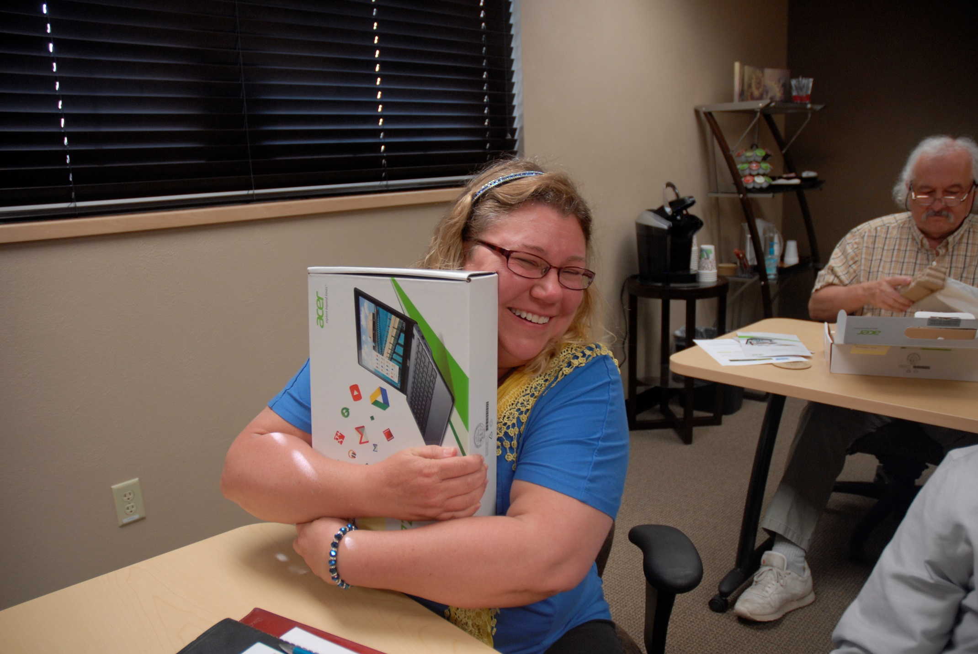

Slide 10
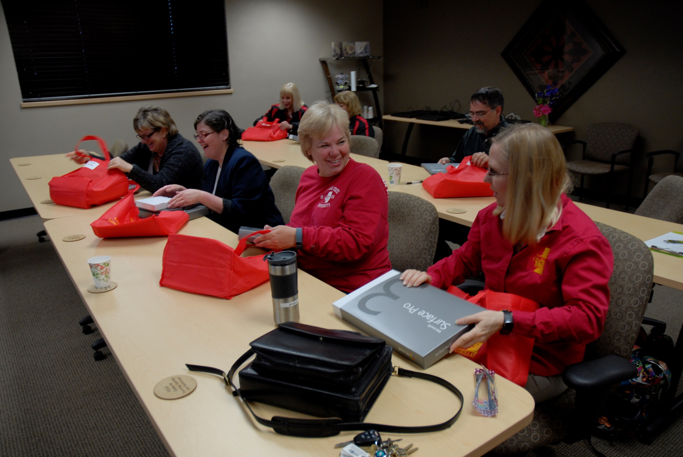

Slide 11
Inside Perspectives

Slide 14
Discussion/Questions
Liz Mascher
Faculty, Teaching & Leadership Department, College of Education
620-235-4082
emascher@pittstate.edu
Susan Dellasega
Instructional Designer, Center for Teaching, Learning & Technology
620-235-4270
sdellasega@pittstate.edu
Dr. Brenda Frieden Director, Center for Teaching, Learning & Technology
620-235-4243
bfrieden@pittstate.edu

