Slide 1

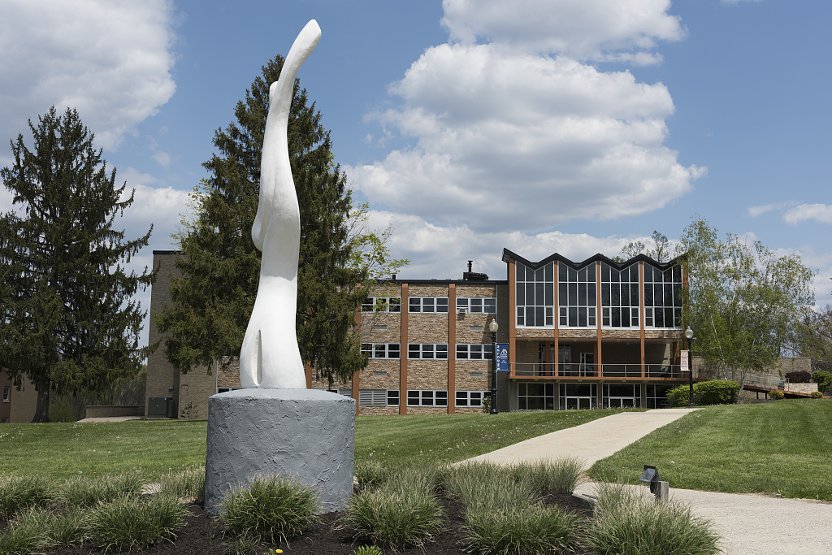

Searching for Sasquatch
#Search4Squatch
Closing the Loop:
Using Quality Matters Course Reviews for Instructional Improvement

Slide 2

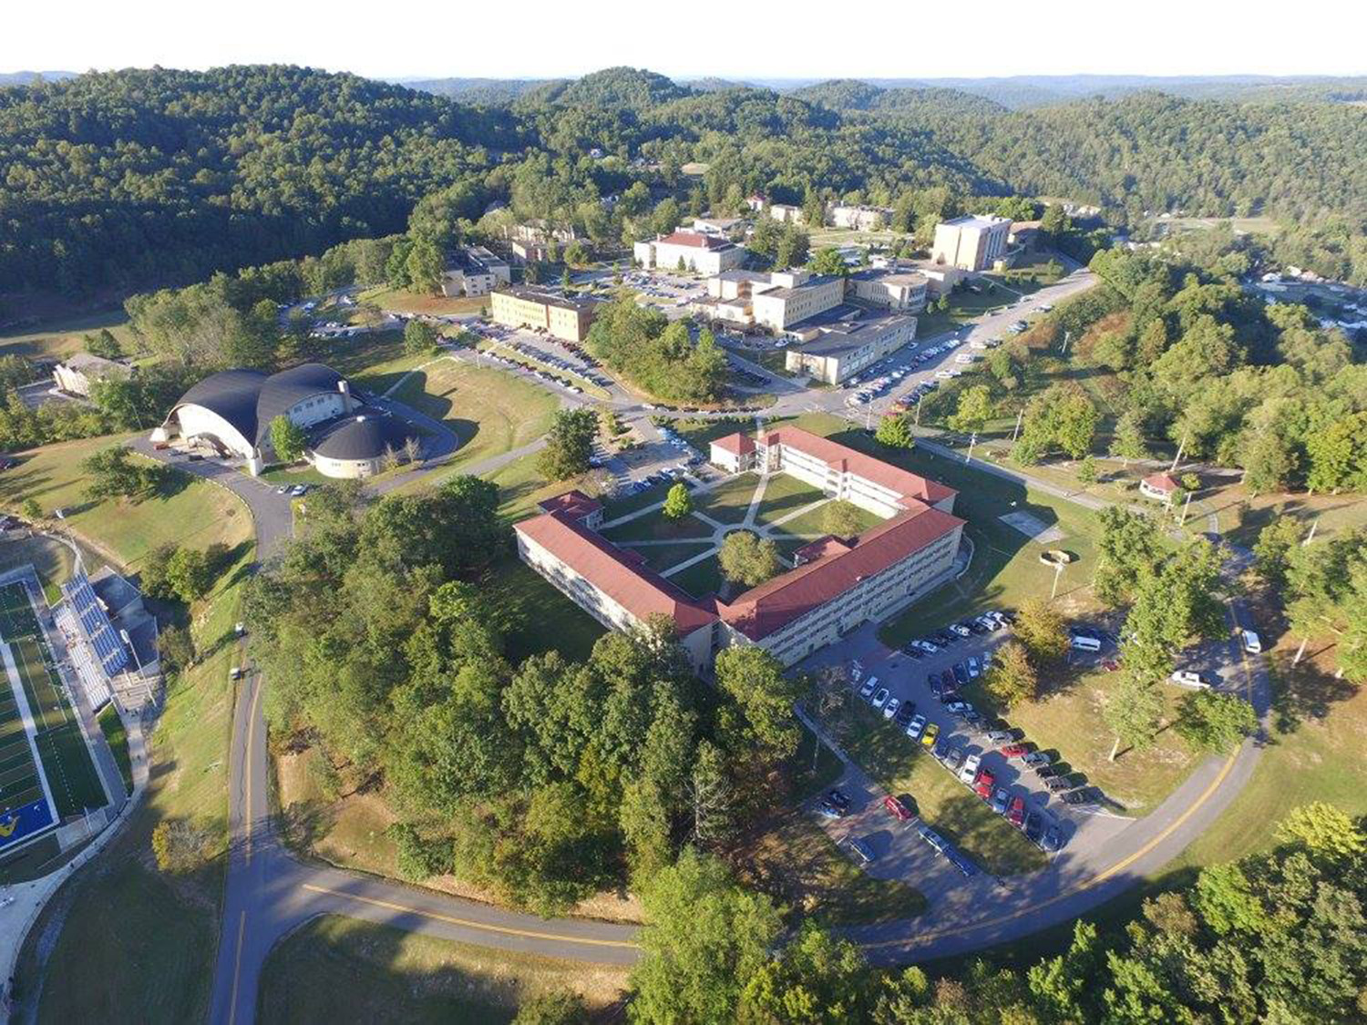
The Hunt Begins
Surveying the Hunting Ground
Alderson Broaddus University
Private, faith based university in north central West Virginia
1000 students, up from 650 in 2012
Approximately 70% are students athletes
From 35 states and 19 foreign countries

Slide 3
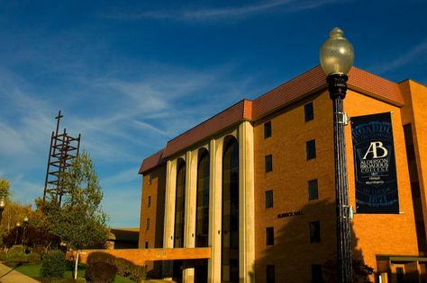
The Need for Data
And a QA Process
Recent but rapid increase in Online Learning
  2013-2014: 9 online courses
  2018-2019:
    2 Fully online degree programs
    Summer – 40 online course sections
    89% of all summer course offerings
Integration of QM standards into seated course delivery

Slide 4
Online Programming Committee
Responsibility:
Establish guidelines and policy for online education
Monitor the design and development of online courses
Collect, analyze, and interpret data on course delivery to ensure a quality learning environment.
Composition:
Online administrator, Instructional Designer, Director of IT, one representative from each college on 2 year rotating terms.
All are Quality Matters trained.

Slide 5
Internal Course Review process
Based on QM:
3 person team (2 needed to meet)
  Online administrator, ID, 1 committee member.
Only mature courses are reviewed
How we differ:
All standards are reviewed even if Standard 2 is not met.
No subject matter expert
Spreadsheet for feedback

Slide 6
The Spreadsheet
Total of all 3 reviews: raw scores and feedback.
  Cost-effective, easy-to-follow, familiar Excel format
Copies sent to faculty and Dean/Chair
  Must have collaboration with others in Academic Leadership
  All deans now required to complete APPQMR
  QM reviews should be part of annual faculty evaluation process.

Slide 8


Slide 9
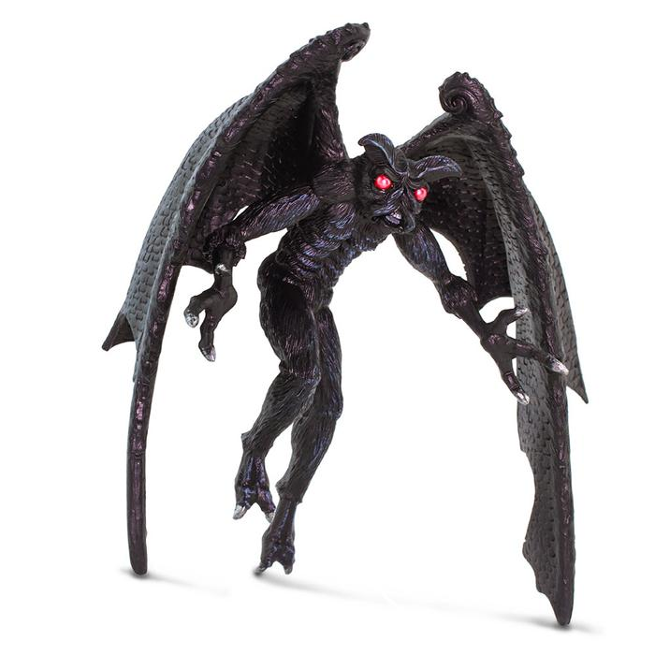
Case #1 – The Stagnant Course
Johnny Irons course has been reviewed several times by OPC with feedback being provided each time per policy. The course is close to meeting the QM standards, but very little change has occurred over the past couple of reviews. Suggestions made as part of the feedback do not appear to have been implemented.

Slide 10
Case #2 – The Resistant Faculty
Robert Coley is the only professor in the Underwater Basketweaving discipline. He asked to transform his seated course into an online delivery format. The dean granted this request. Coley met with the ID when planning the course, but the final course design did not include several of the necessary requirements. Even after several reviews by the OPC, Coley fails to make any changes. He once stated publicly that “No one will tell me how to teach my course.”

Slide 11

Case #3 – The Ineffective Dean
Russel England is a college dean. He has never taught an online course. Although copies of all reviews of online courses are shared with him, faculty from England’s college state that the reviews are never discussed with them, and in fact, the dean does not engage in a regular process of faculty evaluation period.

Slide 12

Necessary Weapons for a Successful Hunt
Build Alliances with:
Faculty from various disciplines
Faculty and staff (ID)
All levels of administration
  Deans
  Provost
  President
Taking Aim with Clear Policies
For Online course development and review
For faculty evaluation, promotion, and tenure

Slide 13
Continuing
Challenges
The “stealth” online course.
How to continue quality assurance once a course meets the QM rubric.
Hybrid courses.

Slide 14
Questions?
Dr. Andrea J Bucklew
  bucklewaj@ab.edu,
  304-457-6438
Mr. Nathan Fortney
  fortneynd@ab.edu,
  304-457-6350

