Slide 1
REVIEW READINESS
Jami Nininger, DNP, Associate Dean
Miriam Abbott, Associate Professor
Mount Carmel College of Nursing
names here?
Establishing internal review processes to prepare for QM certification reviews

Slide 2
OBJECTIVES
Discuss the dichotomy and intersection of academic freedom and structured course design
Strategize structured course design initiatives that promote team trust and collaboration among the faculty team
Appraise institutional internal course review processes that promote evidence-based course design and national quality certification through external review.
Notes:
I never am any good on these. I still like that one guy’s “Learners will leave here with useful information that was heretofore unknown to them” - I love this! However, I added what was present on the abstract :)

Slide 3
Defining Features:
Academic Freedom
Trust
Notes:
Besides establishing the team’s buy - in for the why for the embrace of QM standards and its quality assurance process…Two initial defining features characterize the starting point for this initiative include
1) A high level of academic freedom for faculty
2) A high level of trust in collaboration

Slide 4
Academic Freedom:
Friend or foe?
Image retrieved from https://sciencefordemocracy.org/academic-freedom-and-scientific-freedom-convergence-and-divergence/
Notes:
Regarding the first factor, academic freedom is typically valued in higher education. However, it can create perceived challenges when advocating for particular quality standards. Because maintaining a culture that celebrates academic freedom is essential, a sharp distinction between quality assurance initiatives and content selection should be delineated.

Slide 5
TEAMWORK STARTS AT THE TOP
Notes:
All about you JN. About getting yourself QM certified, learning from other institutions, and bringing it back to us. Reviewing courses, getting invested in revising.

Slide 6
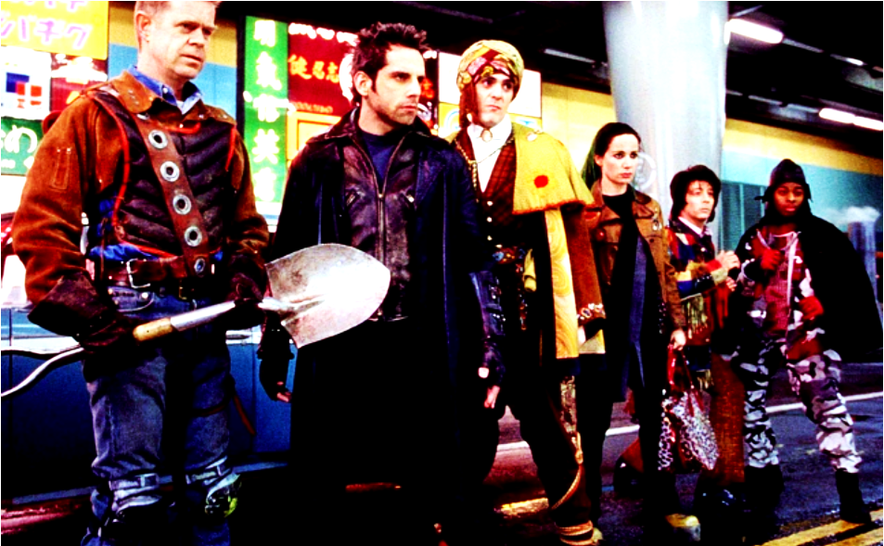
we need some teamwork
do you recognize this team?
Notes:
I’m not sure how this will go over. It’s from a ben stiller movie about a bunch of regular people who decided that their special gifts made them superheroes -and they went around and made a difference with what they had (that’s how I remember it). Having a team does help you understand readiness - because you can share information and patterns with each other.
Regarding the second factor, the cultivation of trust in colleagues and administration is facilitated through frequent contact, and open, transparent communication. Collaboration does not require a consensus in views; it does require openness and compromise.

Slide 7
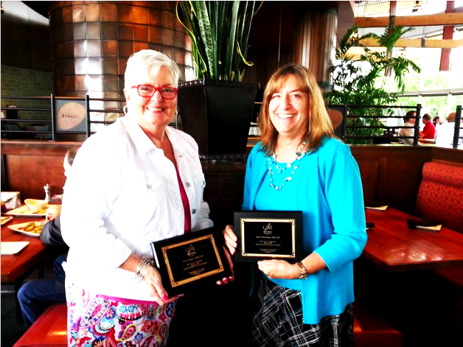
NO . . . You go first
Notes:
Someone has to go first, and these two got our first course certified. They passed on the first try, but they shared potential weak spots from reviewers too (I don’t know what they were, but this detail would be nice)

Slide 8
Mentorship
Templates
Internal review
Notes:
The continued cultivation of these two features throughout the certification process will bolster success of a quality assurance initiative. The institutional approach for mass certification, then, has three prongs:
1) Internal Review
2) Mentorship
3) Templates

Slide 9
Insert carefully …selected Quality Control Agents . . .
Notes:
Attributes of peer reviewers here. Should probably add a slide about templates . . .

Slide 10
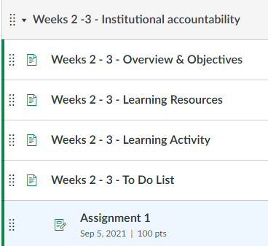
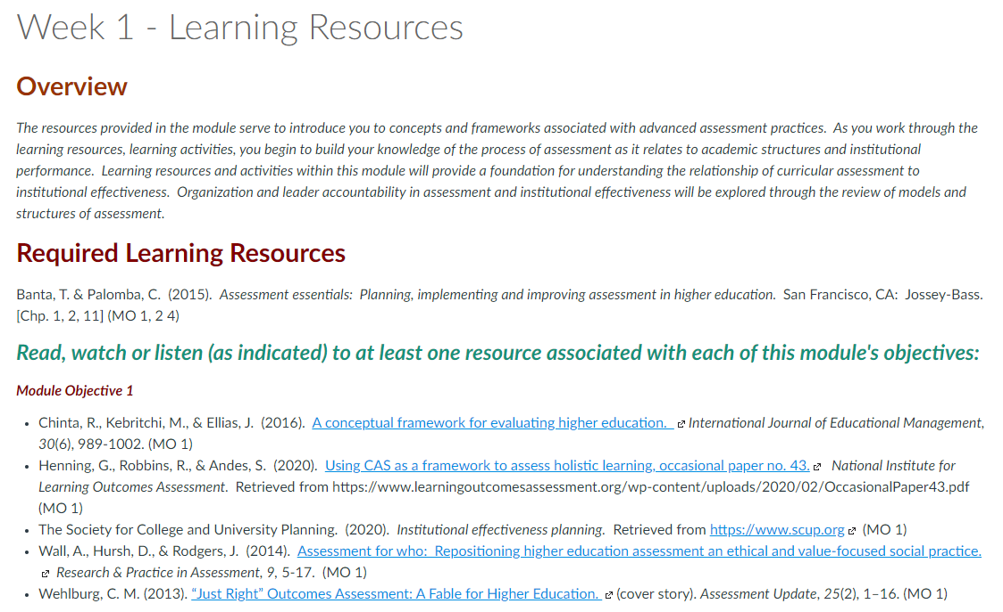
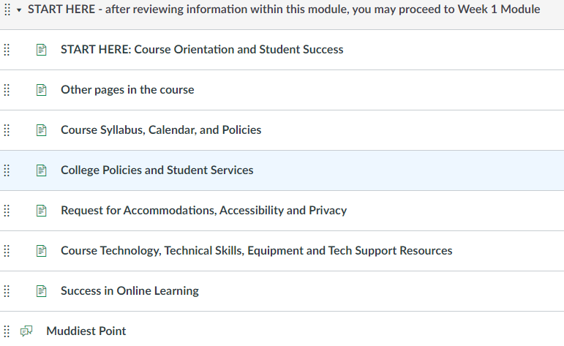
Templates…
Notes:
Addressed identified barrier:
-time
-application of the rubric standards
-foundations for driving consistency and review success

Slide 11
A Few thoughts about fear of failure
Notes:
A little bit about what failing means in QM (it’s not really failing) -because it’s an unknown until it happens to you. Reviewers, in my experience, really DO want you to succeed. Our internal review process follows this premise - helping faculty trust that the process of review is based on design standards and the aim of continuous improvement.

Slide 12
Report back
Modify
Repeat . . . repeat . . . Repeat
Notes:
With each successive review, we learn more, we refine more. For courses within the same program, feedback from external reviewers was shared as a foundation for improving all “like” elements in other courses promoting overall team success in subsequent reviews.

Slide 13
Notes:
everything certified in 18 months

Slide 14
POP QUIZ
The two values we introduced at the beginning were: _____ (5 letters) and
Academic Freedom

Slide 15
POP QUIZ
Teamwork starts at the _____ (3 letters)

Slide 16
POP QUIZ
TRUE/FALSE: If your course doesn’t pass the first time, you’ve blown it and you’re a failure

Slide 17
THANK YOU!
Jami Nininger
Associate Dean, Academic Affairs
jnininger@mccn.edu
Miriam Abbott
Associated Professor, Faculty Fellow
mabbott@mccn.edu
Presentation Template: SlidesMania

Slide 18
REVIEW
READINESS

