Slide 1
Whoa We’re Halfway There, With a Template You’re Halfway There…
Steph Fuhr・Karla Morris・Ricky Zager

Slide 2
About USFSP
University of South Florida Saint Petersburg
Student Population: 6,500
Percentage Online Classes:
  Fall/Spring: 30%
  Summer: 60%
LMS: Canvas
QM Member Since: 2011

Slide 3
OLITS
Instructional Designers
  1 for each college
Professional Development
Video Production Team
Classroom Support
Guide Dog in Training
  Conway!

Slide 4
Course Template
Created our own template
Use as basis for developing courses
Share with those who don’t develop with us
Incorporates many QM standards
Focus on easy to meet, tedious standards
Place holders to help meet other standards
Includes guiding language

Slide 5
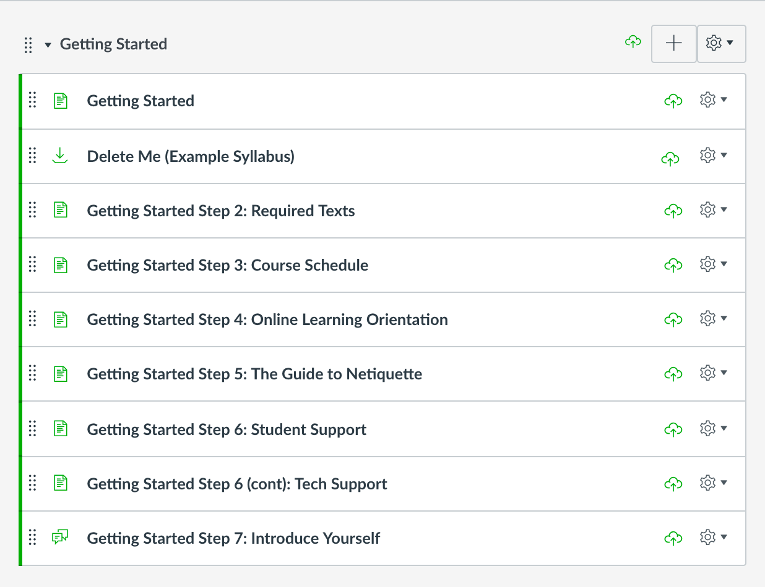
Getting Started Module
Most of the met easy to meet standards are met here
Customizable

Slide 6
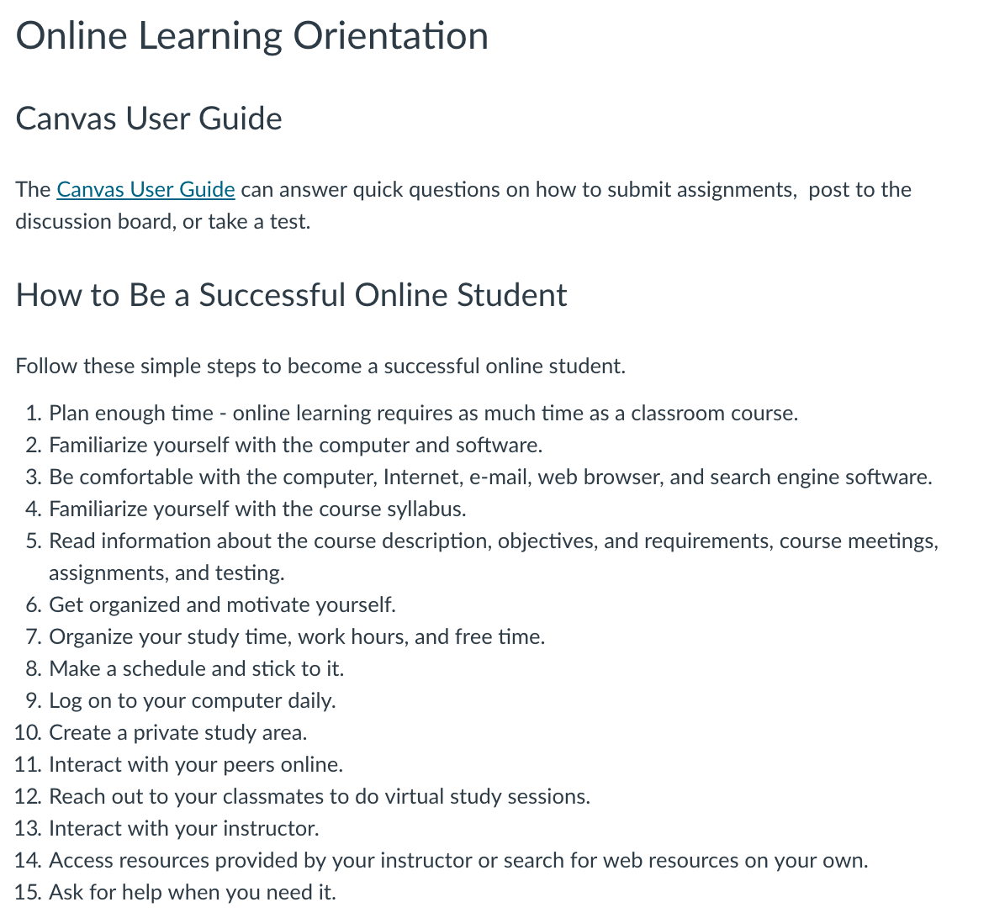
Step 4: Online Learning Orientation
1.5 Minimum Tech Requirements
Expected physical technology: computers, internet, etc.
1.7 Minimum Tech skills
Expected technological proficiencies: email, word processing, etc
Tips on being a successful online student

Slide 7
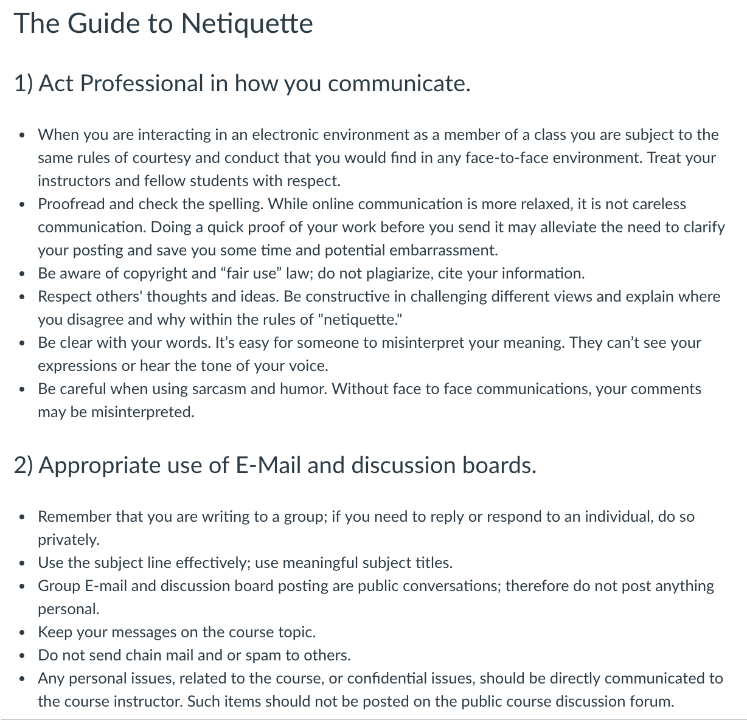
Step 5: Guide To Netiquette
1.3 Etiquette Expectations
Professional communication, email, and discussions

Slide 8
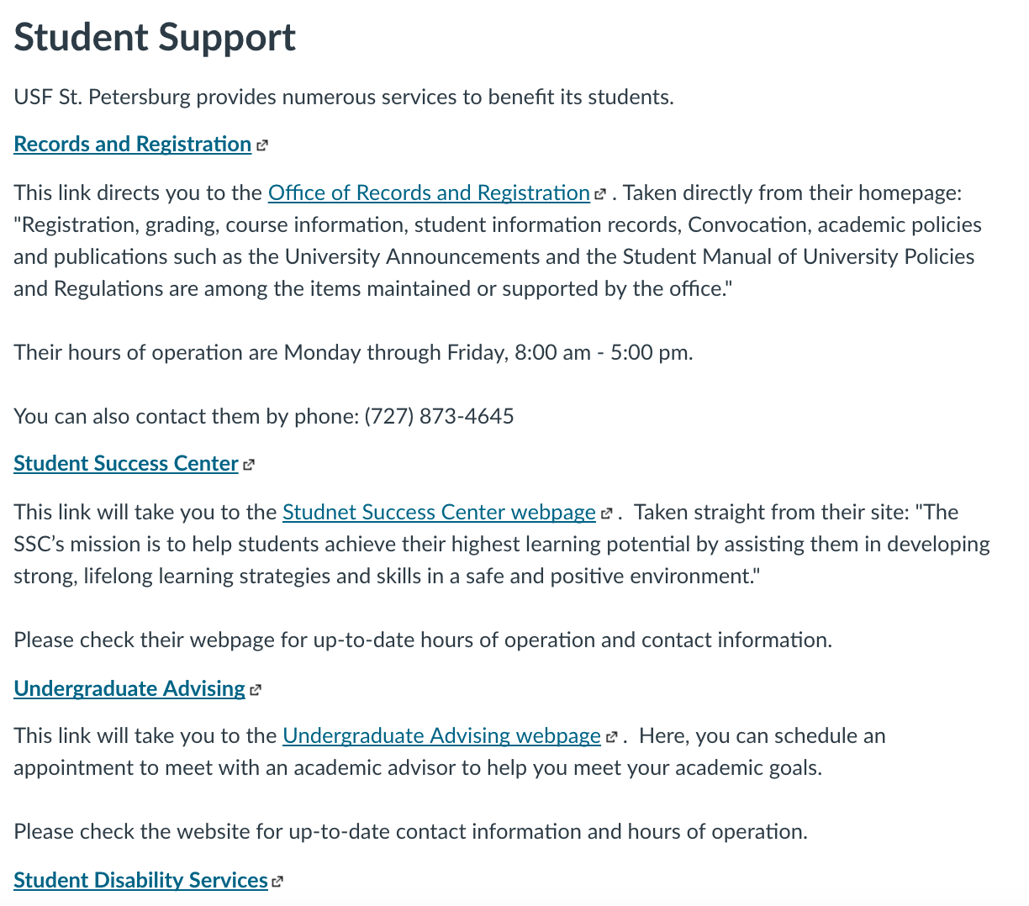
Step 6: Student Support
7.3 & 7.4 support services and resources
Most tedious
Academic support for students
Includes links and information about services
1.4 institution policies: Academic Honesty

Slide 9
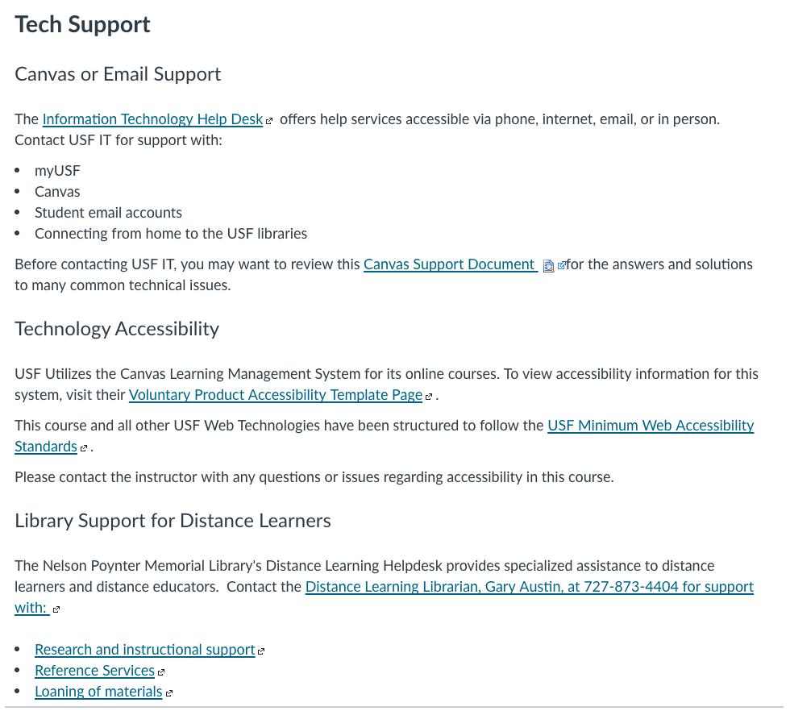
Step 6: Student Tech Support
7.1 Tech support and where to get it
7.2 Institution Accessibility Policy
8.2 Accessibility of Technologies
6.5 Privacy Policies for Technologies

Slide 10
Lessons Learned & New Updates
Getting Started Module as Webpage
USFSP has new website we can edit
Can update links & add new technologies in one place rather than each individual course
Canvas Commons

Slide 11
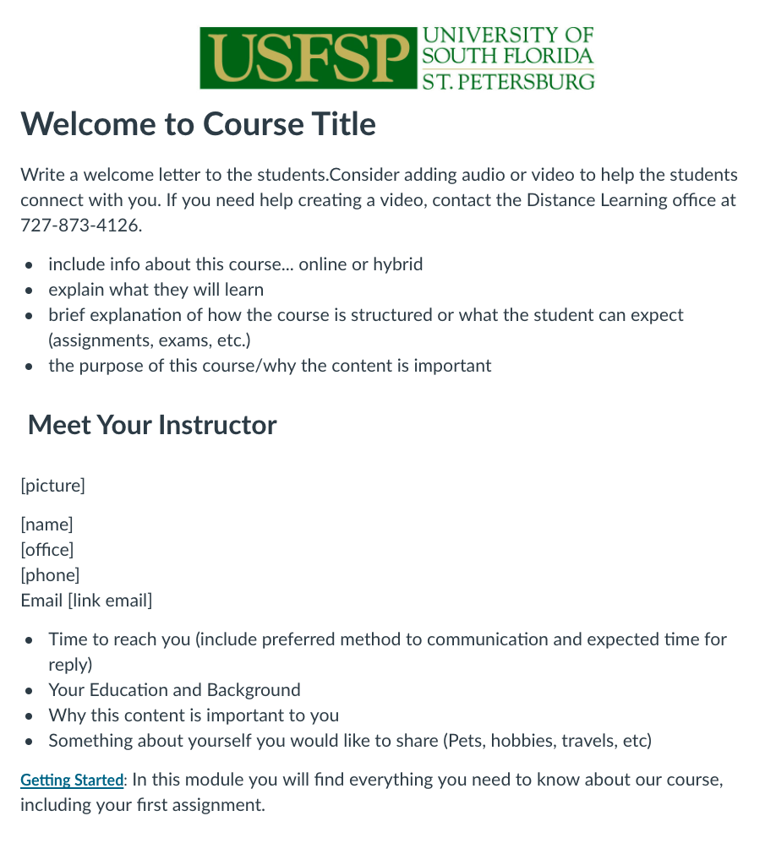
Homepage
1.1 How to get started
1.2 Purpose and structure of the course
1.8 instructor intro
5.3 Classroom response time

Slide 12
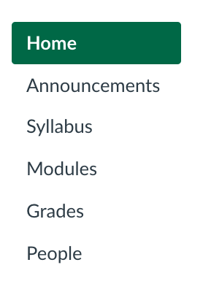
Navigation
8.1 Course Navigation facilitates ease of use
Remove navigation links instructors are not using
Our navigation cannot be renamed

Slide 13
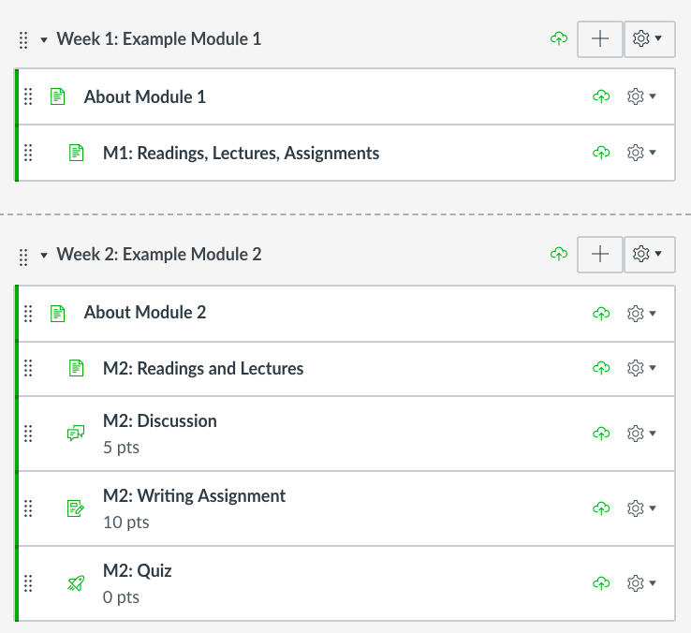
Modules
2 Module formats
  Single Page
  Separate Assignments
Students work though modules to access content

Slide 14
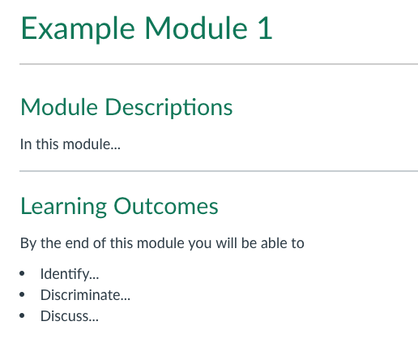
About Module Pages
2.3 learning objectives
Placeholders for Objectives
Hints with Bloom’s verbs

Slide 15
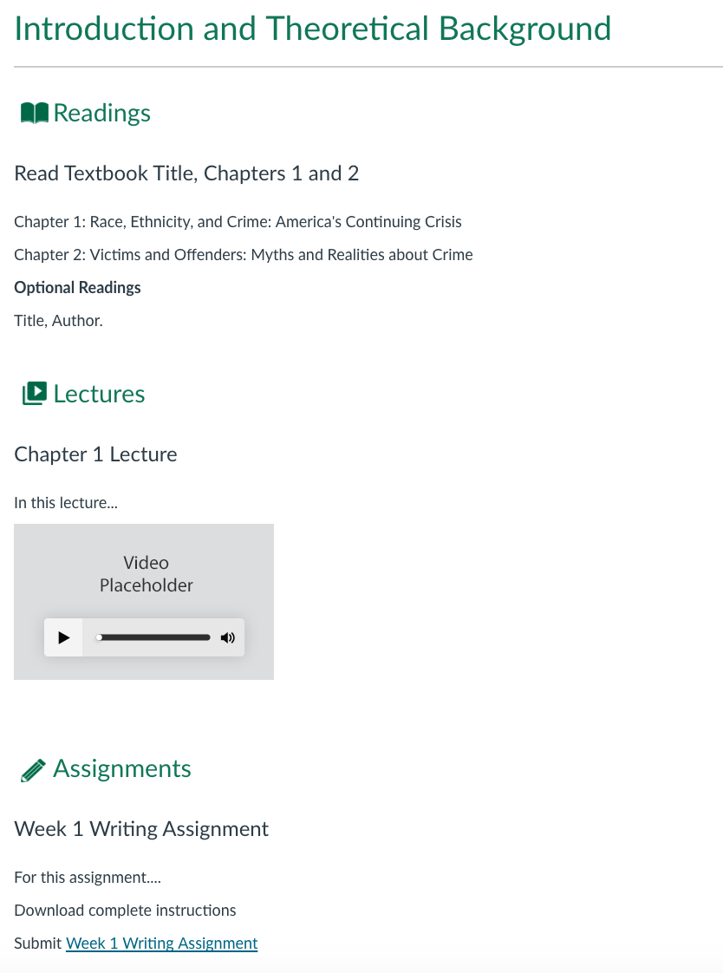
Content Pages
8.4 Readability
Readable, color contrast, font size
4.2 Purpose of instructional materials
4.6 Optional Materials
Placeholders for information about assignments and materials.

Slide 16
With a Template You’re Halfway There
Just by using the template:
Standards Met: 12
Points Earned: 24
Standard Placeholders: 12
Potential Points Earned: 28
Total Standards Addressed: 24
Total Points Addressed 53

Slide 17
QM Certification Process
Very involved with the faculty
Begins with Course Design
Carried through entire development process
Facilitators: IYOC & APPQMR
Review all courses internally
Blog post to recognize faculty

Slide 18
Outcomes
Began course reviews in 2012
17 certified Peer Reviewers that have participated on 18 national course reviews
29 Courses Certified
12 Courses certified in 2016-2017
Goal now is 10 – 15 per year

Slide 19
Thank You
Questions?

