Slide 1

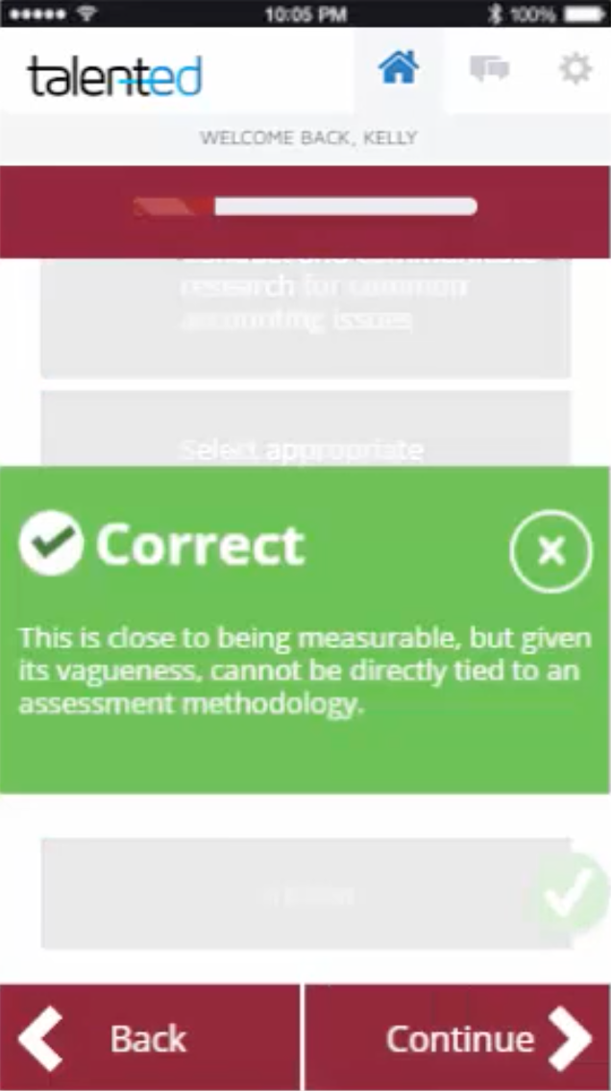



NCCU Has an App
for That!
RE-Applying the Quality Matters Rubric
Through Gamification
Racheal Brooks, Ph.D.
Coordinator, Office of e-Learning
Sujayalakshmi Devarayasamudram, Ph.D.
Assistant Professor, Department of Nursing
Danvers Fleury
CEO, Talented, LLC

Slide 2

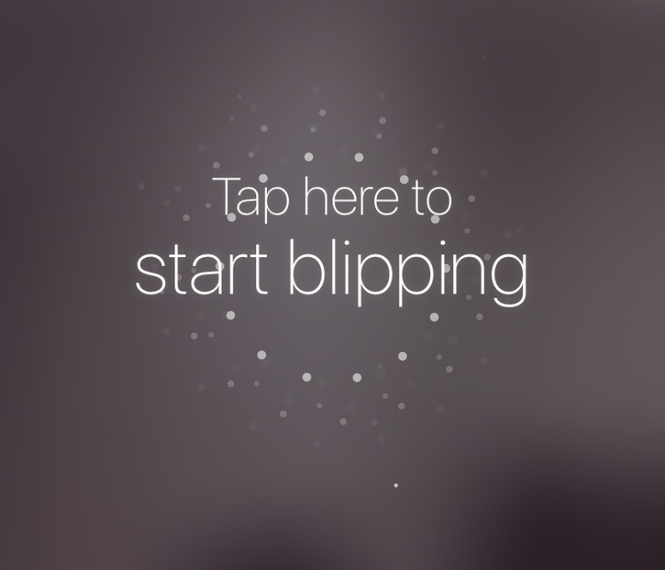
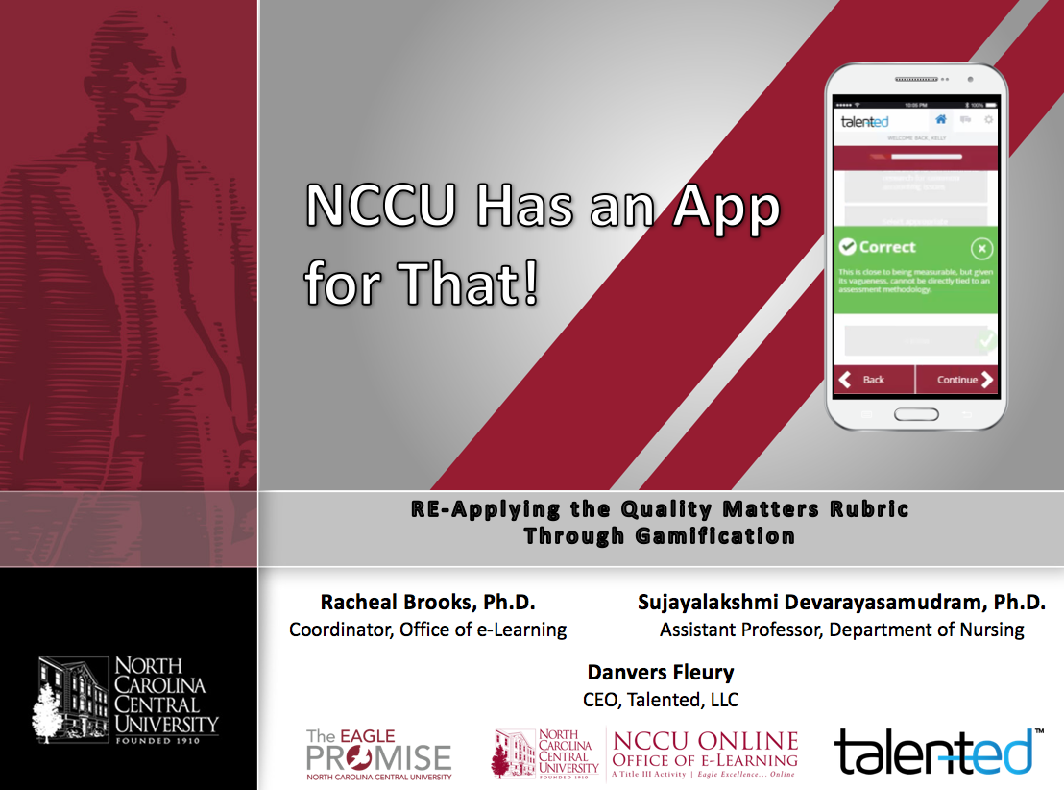

Blippar Download
To access additional resources:
Choose “Settings” from menu
Enter code 766021
Choose Blipp dots from menu
Tap screen to begin
Scan mini-handout

Slide 3
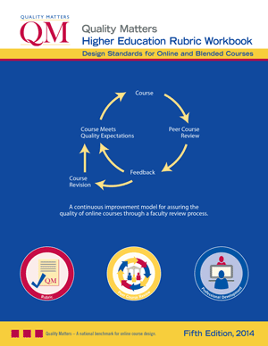
Quality Matters Rubric
Overview
Course Overview Introduction
Course Activities and
Learner Interaction
Course Technology
Learner Support
Accessibility and Usability
Learning Objectives (Competencies)
Assessment and Measurement
Instructional Materials

Slide 4
Applying the Quality Matters Rubric (APPQMR) Workshop
Face-to-face
  One-day (7.5 hours)
Online
  2 weeks
Prerequisite for all QM roles and strongly encouraged for all members
Workshop Components:
  Introduction to Quality Matters
  Detailed review of 8 General Standards
  Application of QM Rubric through collaborative activities
  Utilization of Rubric Standards via “mini-review” of sample course
  Discussion of Reviewer tools and QM resources

Slide 5
APPQMR Feedback
More in depth discussion of nuances of applying those Standards.
More time on the next opportunity.
Hands on activities.
Too long
Need more real examples for each
Standard to get better understanding.
Staying focused on applying the QM design to our course and programs, asking questions about our individual courses
Reduce the time.
The workshop was rather lengthy and should be condensed.

Slide 6


You be the Reviewer
Quality Matters at NCCU
20 Challenges delivered over 6 weeks
3 – 5 Minutes a day
iPhone, iPad, Android, and web compatible
Prior completion of APPQMR workshop

Slide 7


Skill Transfer.
Reaction: Thoughts & feelings about activity
Learning: Increased knowledge & skill
Behavioral Change: Activity driven behavioral change
Results: Activity driven organizational change
Results:
Real World Impact
Reaction Learning Behavioral Change
Structure, Feedback & Accountability
Experience:
Facts, Methods & Behaviors.
Initial Activity
Notes:
Slide says it all!

Slide 8

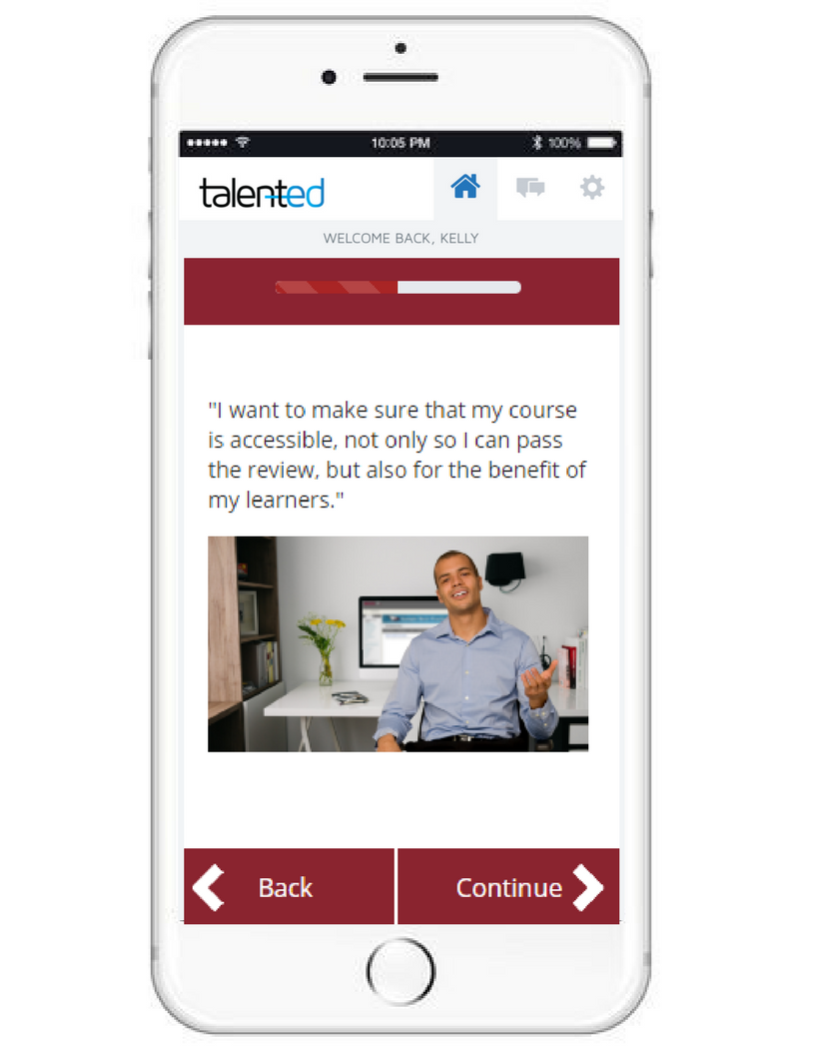
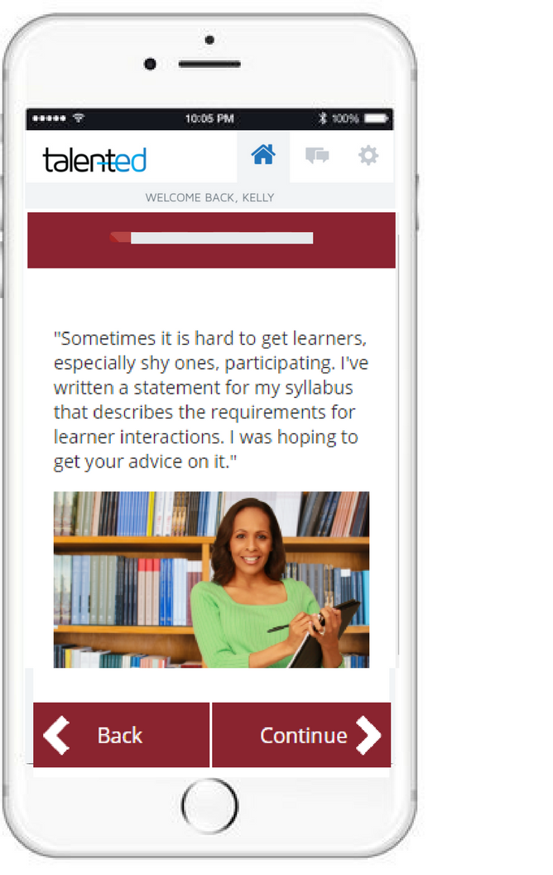

Engage: The Power of Story
Notes:
The research behind Talented is the research popularized in Make it stick : The science of successful learning.
Buzzword soup, or the future of adult education? We think the future, but also the past.

Slide 9
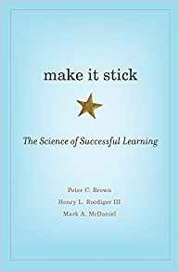
Learn: We Learn by Doing
Engaging & Challenging
Contextually Relevant
Formatively Assessed
Recall & Application
Spaced Over Time
Reinforced by Feedback & Reflection

Slide 10


Change: Real World Stakes
Completion of one of the eligibility prerequisites for new online course creation
A certificate of achievement for CV
Free registration for a future QM Certified Peer Reviewer workshop (a $200 value) and long-term positioning for status as a QM Master Reviewer, which comes with larger stipends
Opportunity to present at QM conferences

Slide 11










The Conversion

Slide 12
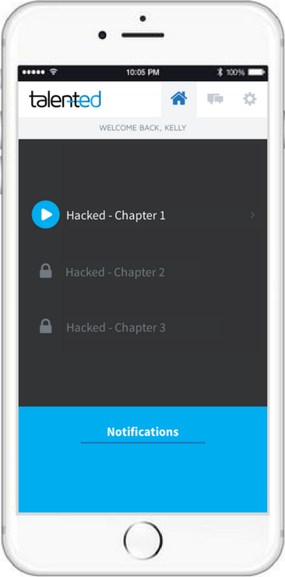
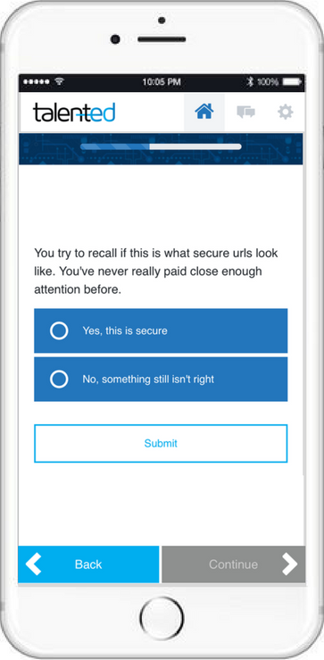
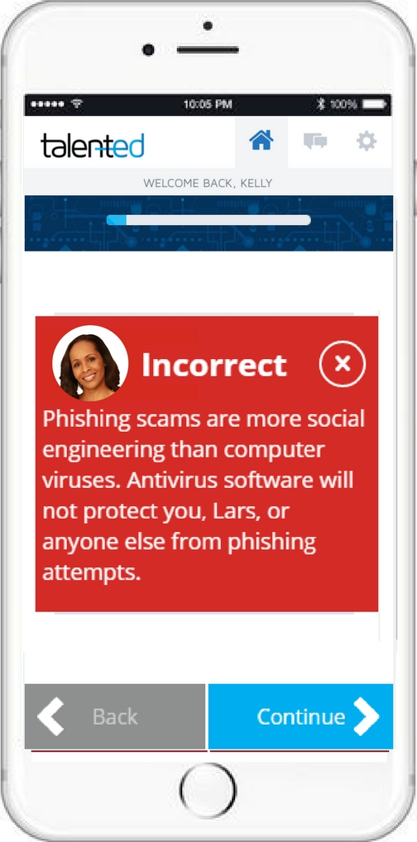




The Delivery
Purpose
Structure
Mentorship
Connection

Slide 13
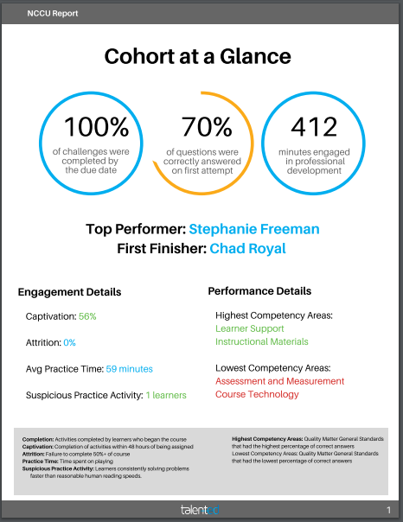
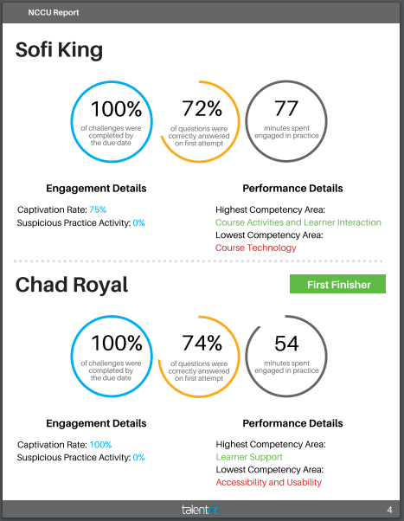
Performance Analytics
Professor 1
Professor 5
Professor 2
Professor 2

Slide 14
Skill Transfer.
Reaction: Thoughts & feelings about activity
Learning: Increased knowledge & skill
Behavioral Change: Activity driven behavioral change
Results: Activity driven organizational change
Results:
Real World Impact
Reaction Learning Behavioral Change
Structure, Feedback & Accountability
Experience:
Facts, Methods & Behaviors.
Initial Activity
Notes:
Slide says it all!

Slide 15
Our Participants
Seven faculty from:
  Allied Professions
  Biological and Biomedical Sciences
  Environmental, Earth and Geospatial Sciences
  Human Sciences
  Language and Literature
  Nursing
  Social Work
Competed during a six-week period beginning October 9, 2017
Eligibility:
  Prior completion of APPQMR
  Access to iPhone, iPad, Android, or web browser

Slide 16
Faculty Perspectives
Benefits of using gamification to reinforce Rubric standards
  Opportunity for professional development
  Personal satisfaction
  Application of skills to improve student engagement and learning outcomes
  Enhances reputation of program, university, and faculty members

Slide 17
Faculty Perspectives
Benefits of using gamification to reinforce Rubric standards
  Supports meeting accreditation standards by aligning courses and meeting standards
    Accreditation Commission for Education in Nursing (ACEN) standards
    National Council of State Boards of Nursing (NCSBN)
  Impact of gamification on faculty stress/anxiety
  Provides opportunities for peer collaboration and competition

Slide 18
Gamification as Professional Development
Learning Environment
Mobile learning increased faculty access to professional development beyond set schedules and locations.
Active Learning
Participants actively engaged in learning challenges by providing APPQMR-informed course design advice to hypothetical colleagues.
Learning Experience
“Chunked” content encouraged faculty to consistently engage with challenges.
Behavioral Changes
Faculty indicated making changes to their course shells.
They also indicated feeling empowered to assist colleagues.
Immediate Feedback
Faculty received immediate feedback for submitted responses and had access to in-app messaging for prompt technical assistance.

Slide 19
Applying What We Learned
Lesson Learned | Future Application
70% Overall accuracy | Increase faculty exposure to QM Rubric Standards via e-learning PD Include mobile app participation as requirement following APPQMR
Potential Competency Area for Improvement: Assessment and Measurement | Reinforce key elements including: aligning assessments with learning objectives; developing effective assessment instruments; providing multiple opportunities to track progress
Potential Competency Area for Improvement: Course Technology | Encourage exploration of course tools that promote active learning and alignment of course technology with learning objectives and competencies

Slide 20
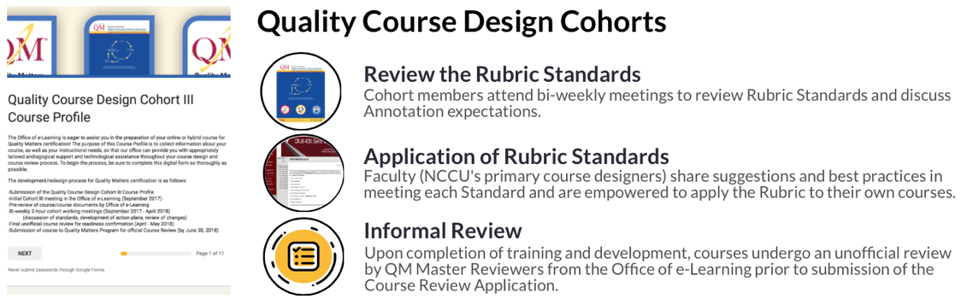
Applying What We Learned
Quality Course Design Cohort III
Hospitality and Tourism Administration
HADM 1000 Introduction to Hospitality Management
HADM 3700 Leadership Colloquium in Hospitality and Tourism
HADM 3800 Human Resources Management
Allied Professions/Communication Disorders
EDSH 5721 Motor Speech Disorders
Public Administration/Executive MBA
PADG 5620 Organizational Theory and Behavior

Slide 21


Thank You to
Our Sponsors

Slide 22
Questions

Slide 23
For additional information, contact:
Dr. Racheal M. Brooks
Coordinator, Office of e-Learning rmbrooks@nccu.edu
(919) 530-6677
Dr. Sujayalakshmi Devarayasamudram
Assistant Professor, Department of Nursing sdevarayasamudram@nccu.edu
(919) 530-6838
Danvers Fleury
CEO, Talented, LLC danvers@talentedapp.com

