Slide 1
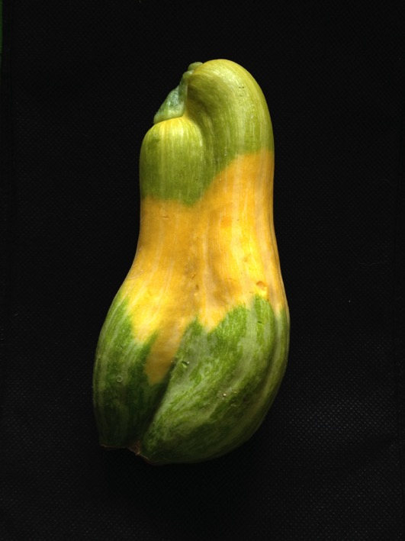
Quality Matters 8th Annual Conference 2017
SoTL from the Start: Incorporating Quality Matters Standards
(Scholarship of Teaching and Learning)
Nancy E. Krusen
Pacific University

Slide 2

Purpose of the paper
The presentation proposes Scholarship of Teaching and Learning (SoTL) intentionally integrated into program development.

Slide 3
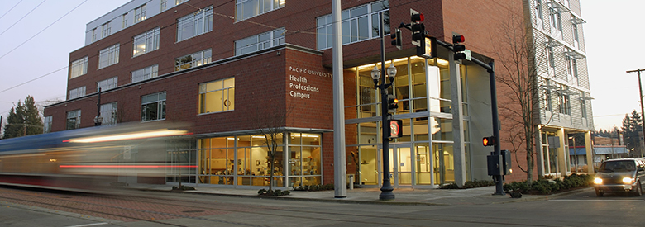

How did we get here?
PhD in Education and Leadership (PhDEL)
First interprofessional graduate program
Joint-degree College of Education and the College of Health Professions
Technology-based, low residency program for the 21st century working professional

Slide 4

Learning Objectives
Participants will be able to:
Design inquiry across SoTL genres, including confirmatory and exploratory research.
Align QM standards with SoTL inquiry to facilitate analysis of curricular design or change.
Identify resources for implementation of SoTL “from the start” projects.

Slide 5
Design inquiry through SoTL
What is SoTL?
Scholarship of teaching is problem-posting about an issue of teaching or learning, study of the problem through methods appropriate to disciplinary epistemologies, application of results to practice, communication of results, self-reflection, and peer review. Cambridge, B. L. (2001)

Slide 6
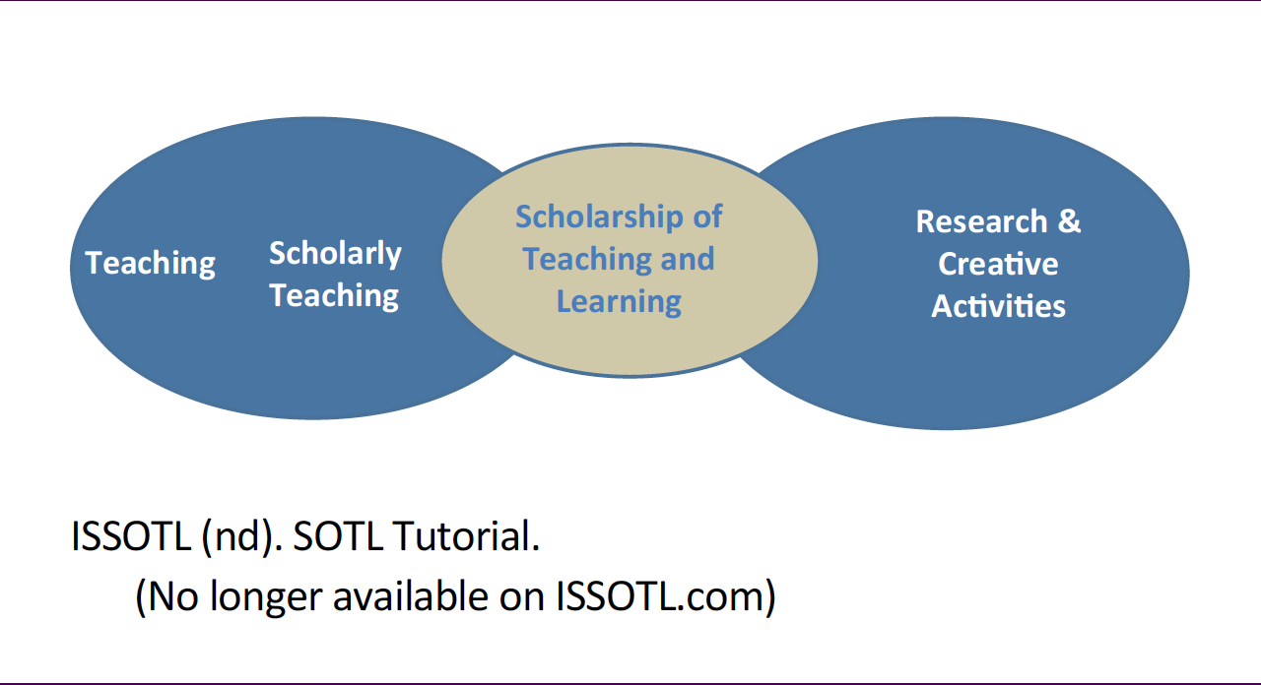
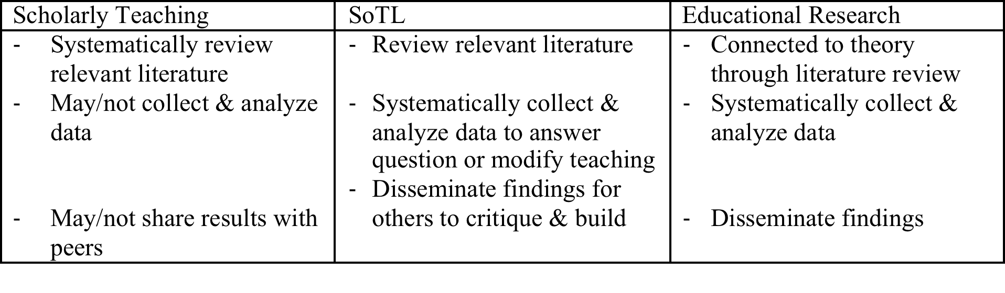
Design inquiry through SoTL

Slide 7
Design inquiry through SoTL
5 Types of SoTL
Group 1: Reports on particular classes
Group 2: Reflections on several or many years of teaching experience, informed by other SoTL
Group 3: Larger contexts: Comparisons of courses & comparisons of student change across time
Group 4: Formal research
Group 5: Summaries & analyses of sets of prior studies
University of Central Florida – Kinds of SoTL Projects
http://www.fctl.ucf.edu/researchandscholarship/sotl/whatIsSOTL/kindsofprojects.php

Slide 8
Align QM standards w SoTL inquiry
Quality Matters General Standards and Rubric:
Course Overview and Introduction
Learning Objectives (Competencies)
Assessment and Measurement
Instructional Materials
Course Activities & Learner Interaction
Course Technology
Learner Support
Accessibility and Usability

Slide 9
Align QM standards w SoTL inquiry
Group 1. Reports on a particular class
Group 1.A. It worked! QM6.1 – 6.4 Course Technology
Q: What is role of technology in supporting PhDEL community?
M: LMS materials, live video conference, recordings, eportfolio, university services, GoogleDrive, screencasting, Mendeley
O: ID new topics, community of practice smooth start up!
Q: How does orientation minimize problems with technology?
M: tutorials, participation required, Q & A
O: all participants on, tech issues resolved prior to class
Notes:
Describe/list QM course overview and introduction

Slide 10
Align QM standards w SoTL inquiry
Group 1. Reports on a particular class
Group 1.B. Before & after: Qualitative assessments & Group 1.C. Quantitative assessments of changes in practice. QM5.2 & 5.4 Course Activities/Learner Interact
Q: How does social presence create a community of scholars?
M: discussion forums, Twitter, videoconference, screen casting
O: in progress, concerns about attendance for live video, concerns about number of discussion posts
Notes:
Describe/list QM learner interaction

Slide 11
Align QM standards w SoTL inquiry
GROUP 2. Reflections on several or many years of teaching experience, implicitly or explicitly informed by other scholarship on teaching
Group 2. D. Essays developing good ideas. QM5.1 & 5.4 Course Activities/Learner Interact
Q: How can modeling use of a journal by instructors support learner professional development?
M: assigned journaling, optional prompts, regular shared posts
O: in progress, video conference discussion about format, use, purpose
Notes:
Describe/list QM learner interaction

Slide 12
Align QM standards w SoTL inquiry
GROUP 3: Larger contexts: Comparisons of courses & comparisons of student change across time
Group 3. G. Qualitative studies designed to explore a key issue. QM8.1- 8.5 Accessibility & Usability
Q: Does the infrastructure support recruitment of diverse learners? retention? engaged student success? meet learner needs?
M: tracking learner background, concerns, progress; instructors?
O: in progress, how will we grow to suit learners?
Notes:
Describe/list QM learner interaction does this turnip truck deliver turnips in a way that suits the needs

Slide 13
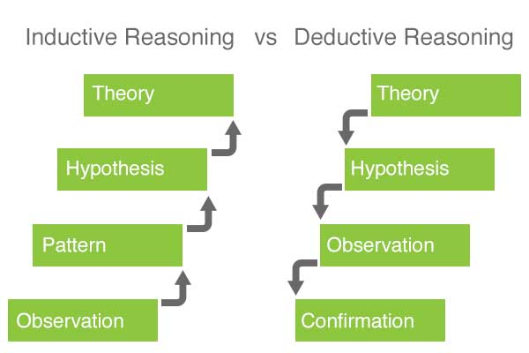
Align QM standards w SoTL inquiry
Exploratory
Confirmatory
Inductive = Using data to form theory
Deductive = Testing theory with data

Slide 14
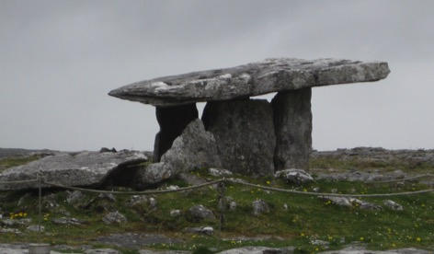
Align QM standards w SoTL inquiry
Writing across the curriculum develops scholarship
Exploratory/ Inductive
Learners write professional journals for each course.
Learners identify scholarly interests in journal entries.
Interests develop into studies.
Writing across the curriculum support development of scholarly research.
Confirmatory/ Deductive
Theorists propose writing to facilitate scholarship.
PhDEL requires journal writing.
Observe changes in writing.
Confirm research stems from journal writing.

Slide 15
Tailor your SoTL inquiry
Identify specific scholarly question
Describe importance of topic
Compose literature review (or annotated bib)
Describe the design, data, collection methods
Discuss patterns, findings
Propose new hypothesis or confirm existing
Summarize conclusions, future research
Apply, disseminate, invite dialog

Slide 16
Tailor your SoTL inquiry
QM1.2 Course Overview & Introduction
When I use a syllabus quiz will I have fewer emails asking questions about …
QM2.4 Learning Objectives
I added specific learning objectives to each assignment. Will course feedback show that students understand the relationship to the course?
QM3.4 Assessment & Measurement
Will student competencies for ___ improve when I split the assignment to be both formative and summative?

Slide 17
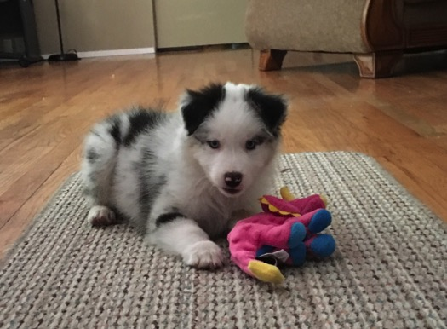
Key messages
QM Higher Education rubric can help focus SoTL questions.
SoTL questions cross professional boundaries for curricular development.
There are a variety of genres of SoTL questions.
Bright Eyes Merrihueite
“Merri”

Slide 18
Resources
Cambridge, B. L. (2001). Fostering the scholarship of teaching and learning: Communities of practice. In D. Lieberman, & C. Wehlburg (Eds.), To Improve the Academy (pp. 3-16). Bolton, MA: Anker.
McDonald, P.L., Lyons, L.B., Straker, H.O., Barnett, J.S., Schlumpf, K.S., Cotton, L., and Corcoran, M.A. (2014). Educational mixology: A pedagogical approach to promoting adoption of technology to support new learning models in health sciences disciplines. Online Learning. 18 (4): 33-50.
Nelson, C. E. 2004. Doing It: Selected examples of several of the different genres of SOTL. Journal on Excellence in College Teaching. 14 (2-3), 85-94.

Slide 19
Resources
Nelson, C. E. 2014. An idealized model for designing, presenting and analyzing SoTL projects. National Teaching and Learning Forum 23(3),1-5.
Salmon, V. N. (2004). Practicing Boyer's scholarship of integration: A program for community college faculty - revised. Teaching English In The Two-Year College, 32(1), 64-70.
Wilson-Doenges, G., & Gurung, R. R. (2013). Benchmarks for scholarly investigations of teaching and learning. Australian Journal Of Psychology, 65(1), 63-70.

Slide 20

Comments? Questions?
Nancy E. Krusen, PhD, OTR/L nekrusen@pacificu.edu

